Slide 1
Role of Equipment Master Data for Successful Digital Twins
Mohammed Al Hashim
Lead Business Systems Analyst
Saudi Aramco
October 17th, 2023

Slide 2
Agenda
Current Reality & Challenges
Master Data Management Pyramid
Master Data Management Framework
Master Data Management Journey

Slide 3
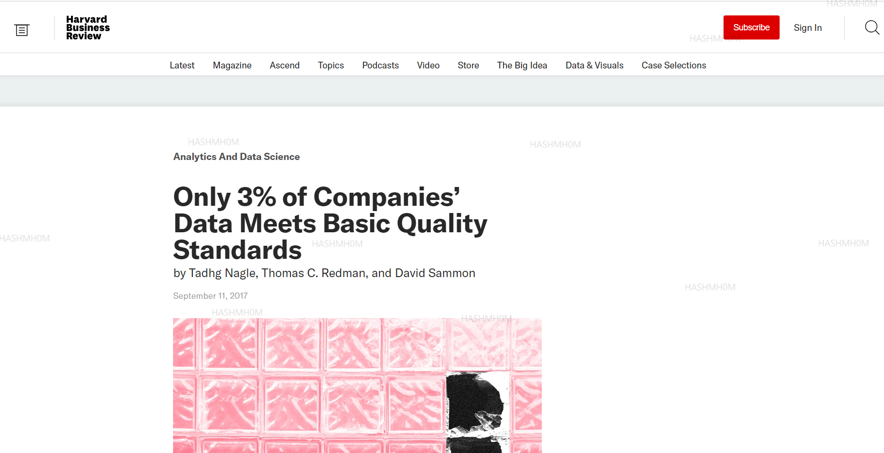
Current Reality & Challenges

Slide 4
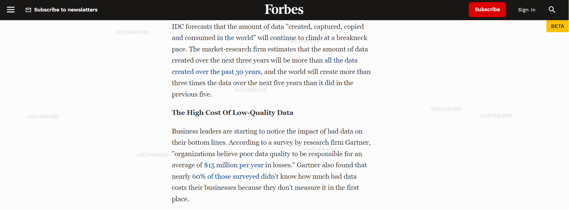
Current Reality & Challenges

Slide 5
Current Reality & Challenges

Slide 6
Common Equipment Data Issues
Inconsistent Equipment Taxonomy for Same Equipment Type (Make & Model)
Inconsistent data
Equipment records having Model with N/A, #, warranty dates, … etc.
Missing values
Duplicate entries
Unstructured data
Data inaccuracy
Equipment record repeated twice
Vital Equipment characteristics like: impeller diameter, bearing type, … etc. captured in the description, attachments
Equipment having zero acquisition value

Slide 7
Master Data Management Pyramid
Data-Driven Decisions
Digital twin layer
AI and machine learning layer
Data quality layer
Foundational layer
Virtual Replica of Physical Asset
Wisdom
Augment Invalid Data
Knowledge
Equipment Data KPIs
Information
Data Management & Governance
Data

Slide 8
Master Data Management Framework
Digital twin layer
AI and machine learning layer
Data quality layer
Foundational layer
Establishing Roles & Responsibilities for Stakeholders
Data Governance Strategies, Policies & Standards
Investing in Data Governance Solutions

Slide 9
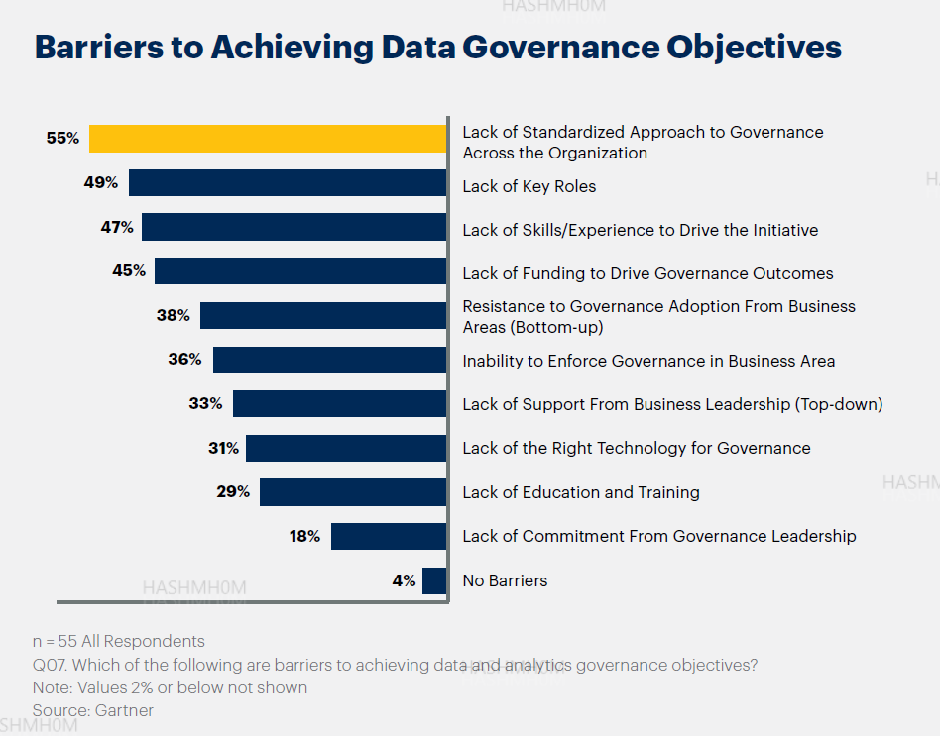
Master Data Management Framework

Slide 10
Master Data Management Journey
Set the Right Foundations for Data Management through Corporate Strategies
Establish a KPI for Monitoring Data Quality
Assign Roles & Responsibilities for Data Management from Lowest level to Highest
Invest in Data Management & Governance Solution(s)
Gradual Implementation Strategy based on Prioritization

Slide 11
Master Data Management Journey
What is a Digital Twin? % Asset Manintenance – MACS
https://macs.eu/what-is-a-digital-twin/

Slide 12
Thank You
Notes:
This concludes my presentation, and I will be glad to answer any questions you have. Thank you

