Slide 1
Empowering critical decisions utilizing your digital twins
10 lessons learned leading to increased ROI
Kjell Eriksson

Slide 2
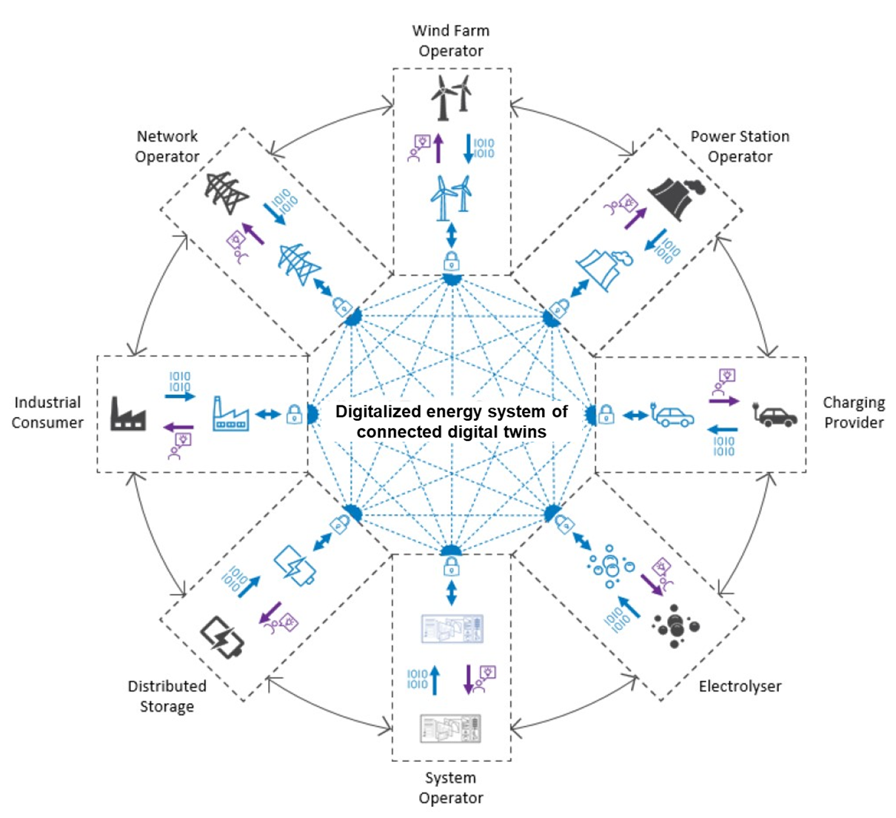
The digital transformation is key to safeguarding energy supply while decarbonizing and electrifying the society
Notes:
We firmly believe that the digital transformation is key to safeguard energy supply in its current form while at the same time decarbonize and electrify the society.
We also expect that we are moving towards an energy system consisting of connected digital twins.

Slide 3
What is a Digital Twin?
Digital twin
A digital twin is a virtual representation of a system or asset, that calculates system states and makes system information available, through integrated models and data, with the purpose of providing decision support, over its lifecycle.
Physical
Virtual
Work Processes
Actions
Decision support
Computation models
Data
Asset Information Model
Notes:
Before going on - what exactly do we mean by digital twins?
Several organisations and companies have their own definitions and although we all use slightly different words, the meaning is pretty similar. We describe a digital twin as a virtual representation of a system or asset, that calculates system states and makes system information available, through integrated models and data, with the purpose of providing decision support, over its lifecycle.
It is a question of transferring data like engineering or fabrication records, transactional data like work orders and notifications or live / streamed data from sensors or instruments from the physical installation, contextualizing the data through an asset information model to ensure that the right data is connected to the right equipment or system, apply analytics through computational models and convert the result into insights for decisions that can then be implemented through work processes and actions on the physical installation.
Control systems, algorithms and embedded systems that are an integral part of the asset are not considered a DT but rather a cyber-physical system. In cyber-physical systems, physical and software components are deeply intertwined and interact with each other to enhance the functionality, performance, safety, etc. of the system. There are two reasons for making this distinction:
The consequence of a failure in a cyber-physical system is typically higher than a failure in a digital twin, hence a different level of assurance is required.
A cyber-physical system will typically be subject to the standards and regulation imposed on the asset that it is installed in.
A computation model from a cyber-physical system or control systems may be mirrored in a DT, for instance in a system-of-systems model, to replicate the response of the system. Also, there could be embedded systems on the physical asset that are required for the DT, for instance to provide the required sampling rate from instrumentation.

Slide 4
Capabilities and areas of application
Automated
Prescriptive
Level of complexity
Predictive
Diagnostic
Descriptive
Component
System
Asset / Facility
Enterprise
Notes:
The definition on the previous slide is still a bit wide and to better be able to define the use of the digital twin we have defined 5 areas of capability CLICK
Descriptive
The current state is described and visualised. This could for example be a 3D model
Diagnostic
By adding sensor information to the descriptive model decisions about current state or condition can be made
Predictive
By adding intelligence and analytics to the diagnostic model one can start to predict future states like remaining useful life
Prescriptive
Adding more advanced intelligence, the digital twin will be able to provide recommended actions based on the actual condition, like for example replacing a part within a certain timeframe
Automated
And ultimately by connecting the digital twin to the administrative or process system, the digital twin could generate actions automatically – i.e. closing the control loop. At this level the digital twin will start to have functionality like a control system and care should be taken when specifying requirements to ensure that safety levels are maintained.
CLICK
The other dimension is area of application. A digital twin could a address one or several components, a system, or a complete set of systems making up a complete asset or facility, and ultimately addressing an entire enterprise consisting of several assets.
CLICK
Perhaps needless to say, the higher the capability and the broader the areas of application the more complex the digital twin will get.

Slide 5
What have we observed
Digital twins are primarily a complementary source of information
Need to get the foundation right – and it is hard work
Machine learning (ML) has significant potential – but it is early days
Significant potential for condition-based maintenance (CBM) but…
Increased awareness of data quality as data is used in new ways
Solutions must be integrated in work processes to be sustainable
A common digital architecture is emerging
Emerging information models addressing the entire life cycle
Growing cyber security threat and awareness – there is a job to be done
Increasing regulatory complexity
Notes:
A complementary source of information
An important part of the assurance process is to understand how the digital twin is used and to thereby establish the right level of assurance measures. The higher the criticality of the digital twin, the stricter measures are needed with respect to data quality and algorithm performance. On the other hand, it is important to find the right balance not to implement too stringent assurance requirements for less critical applications.
DNV’s experience is that currently digital twins are primarily used as complementary source of information supporting a decision-making process rather than being used as the only source of information. Using digital twins for more advanced / autonomous use-cases will require a more stringent approach to data quality, algorithm performance and software cording, in line with how industrial control and automation systems are managed.
Getting the foundation right
As mentioned previously digital twins range from descriptive where data and information is collected and displayed like a 3D model or a dashboard, via predictive and prescriptive where data and algorithms are added to the digital twin to enable predictions about aspects like future states and remaining life, to automated where the digital twin will act based on the data information it is receiving and processing. Most digital twins that we have come across are descriptive in their nature. And we note the significant efforts that are needed to build a robust foundation linking data and information from different sources into the digital twin. It can be easy to underestimate the sometimes not very visible effort that is needed to build a strong foundation. NV’s experience is that it is not feasible to create a highly advanced digital twin without a proper foundation with structured and contextualized data. Building that foundation takes time and effort.
Machine learning
In addition to the assurance tasks that DNV have undertaken, we have also conducted a large survey on behalf of the Norwegian Research Council on the state and potential of machine learning in the offshore oil and gas industry. Machine learning has significant potential especially for reduced GHG, reduced well delivery time, reduced OPEX and accelerated production. However, it is early days and significant efforts are needed to scale up the activity. Of all machine learning initiatives only 10% were implemented and operational. The remaining where either conceptual or pilot stage. DNV’s reflection is machine learning is transformative and requires digital leadership, full exploitation of the data, and new process and skills. Machine learning pilots will not bring sustainable change and value unless scaled and broadly adopted.
Condition based maintenance (CBM)
The basic principle for CBM is to identify degradation as function of time, give early detection, and take remedial actions, i.e., planning and process changes, to avoid plant shutdown and costly repair. Currently 30% of maintenance is condition-based. By using by utilizing sensors, models and statistical data in combination and apply machine learning it should be possible to move from ca. 30% to 60% CBM. DNV’s reflection is that current speed of development on advanced digital technologies like sensors, advanced data analytics and machine learning will increase the uptake of CBM significantly thereby reducing operating costs. We expect that analysis of maintenance records combined with machine learning solutions that can identify slow moving trends over long time periods can be very powerful decision support tools. However, CBM will not “heal” the equipment and repair needs to be done also in the future. There may also be contractual aspects like warranties etc that can limit the uptake of CBM.
Data will be used in new ways
With increased use of digital twins comes a need to rethink how data quality is managed. Traditionally data has been created for a specific purpose with data quality metrics established for that particular use case. In digital twins used for diagnostic, predictive and prescriptive purposes, data will be consumed from several different sources with different requirements to data quality aspects like timeliness, accuracy, completeness, etc. When merging the data from these different sources one must ensure that the quality of the data is suitable for the new application / use case. Our recommendation is that requirements to data quality is clearly defined and addressed when specifying the different use cases and functions of a digital twin recognizing that the data that will be consumed comes from different sources with different intended use and related requirements.
Integration into work processes
From own observations and in dialogue with other organisations we see that keeping a digital twin sharp and valid over time is a key challenge. Often development and application digital twins are initiated by an enthusiastic team with a passion and interest in new solutions. However, unless the digital twin is identified and managed as a key system, integrated in existing work process, subjected to a management of changes process, and continuously updated to accurately represent the physical asset at any one time, the digital twin tends not to be used after a couple of years. DNV recommends that considerations on how digital twins shall be managed to remain valid over time is addressed early in the development process to ensure that they stay sharp and create sustainable value. Failure to do so will most likely result in a situation where the digital twin tends not to be used after a couple of years.
Digital architecture
The ongoing data liberation drive is enabled by a new digital architecture that we see with many of our clients. Where data and information traditionally has been locked in silos and end-to-end solutions from every sensor, via analytics to dashboards and presentation of results has been provided for different types of equipment and systems, we now see a growing use of a data contextualisation layer / data platform at the centre of the architecture enabling a much more dynamic consumption of data for different use cases and functional elements. DNV’s reflection is that moving toward an architecture where data can easily be consumed by the different functional elements of a digital twin is key to succeeding with implementing digital twins. Lock-in of data should be avoided and care must be taken when reviewing terms and conditions for different applications and source systems to ensure that data can be shared as needed.
Emerging information models
The asset information model is the backbone of a digital twin. A challenge for the industry is the recreation of digital information models at every stage that information changes hands, typically between subcontractors and main contractor and from the project execution phase to operations. The recreation of digital information models causes inefficiencies and increases the risk of entering incorrect data. One initiative trying to establish a sustainable solution is the READI Joint Industry Project. The objective of READI is to shape the future of digital requirements and information flow in the oil and gas value chain. The idea is to create a solution that will enable computers to read and perform automatic reasoning on requirements to validate consistency and verify engineering and operational data with accuracy at minimal cost and time expenditure from concept definition to decommissioning. The solutions from READI are explored by leading operators and contractors. DNV’s reflection is that we are moving from documents to digital representation of asset information enabled by machine readable and reasonable standards and technology. We expect to see increased technology development and uptake of new solutions in the near future.
Upcoming regulations
The European Union is working on new regulations related to artificial intelligence (AI) that most likely will have an impact on digital twins for the energy sector. The new regulations are expected to come in to force in 2023 with a grace period towards 2025 for full implementation. The draft regulations apply to high-risk AI and coverer both embedded AI in products and stand-alone AI products and services​. Management and operation of critical infrastructure is defined as high-risk applications. The definition of AI is relatively broad in the upcoming regulations “artificial intelligence systems mean software that is developed to generate outputs such as content, predictions, recommendations, or decisions​”. Applications currently include machine learning​ and logic- and knowledge-based​ statistical​ methods. The draft regulation further states that both the designer and the user of high-risk AI systems will have to comply with the AI Act. Given the broad definition of AI and the definition of management and operation of critical infrastructure as a high-risk application, DNV’s reflection is that several digital twins used in the oil, gas and energy sector will have to comply with the EU AI Act.
Growing awareness of cyber security
Digital transformation can increase efficiency and generate new and increased value. But increased digitalization introduces new risks. The more digital an organization gets the higher the exposure to cyber security attacks. Energy is one of the top three industries reporting cyber-attacks [8] and it faces specific challenges. While all industries must prevent hackers from stealing sensitive data from their information technology (IT) environments, energy businesses also need to manage the threat to their operational technologies (OT) – the computing and communication systems they use to manage, monitor, and control industrial operations. As OT systems have been operated in siloed environments and hence been more protected, organizations have understandably prioritized cyber upgrades to their IT system. DNV estimates that there is a gulf in maturity of approximately 15 years on cyber security in OT systems versus IT systems. In a recent survey among executives in the energy sector 85% state that an attack leading to operational shutdownes are likely in the next two years. 85%! DNV’s recommendation is the cyber security is addressed at all levels of digital twin solutions from the functional element via the data platform to the source systems and OT solutions. Cyber security should not be handled as “something IT will fix”.

Slide 6
Increased return on digital investments
Automated
Prescriptive
Increased return on investment
Predictive
Diagnostic
Building the foundation
Descriptive
Component
System
Asset / Facility
Enterprise
Notes:
The definition on the previous slide is still a bit wide and to better be able to define the use of the digital twin we have defined 5 areas of capability CLICK
Descriptive
The current state is described and visualised. This could for example be a 3D model
Diagnostic
By adding sensor information to the descriptive model decisions about current state or condition can be made
Predictive
By adding intelligence and analytics to the diagnostic model one can start to predict future states like remaining useful life
Prescriptive
Adding more advanced intelligence, the digital twin will be able to provide recommended actions based on the actual condition, like for example replacing a part within a certain timeframe
Automated
And ultimately by connecting the digital twin to the administrative or process system, the digital twin could generate actions automatically – i.e. closing the control loop. At this level the digital twin will start to have functionality like a control system and care should be taken when specifying requirements to ensure that safety levels are maintained.
CLICK
The other dimension is area of application. A digital twin could a address one or several components, a system, or a complete set of systems making up a complete asset or facility, and ultimately addressing an entire enterprise consisting of several assets.
CLICK
Perhaps needless to say, the higher the capability and the broader the areas of application the more complex the digital twin will get.

Slide 7
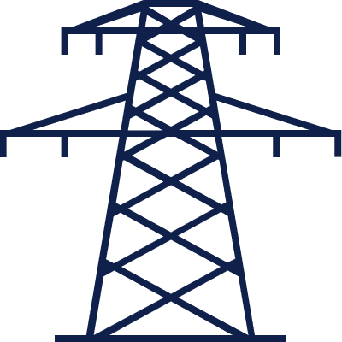
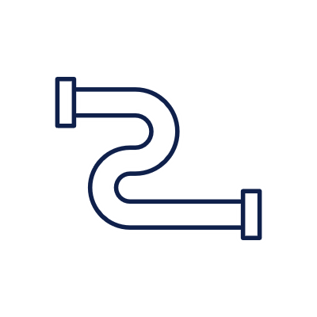
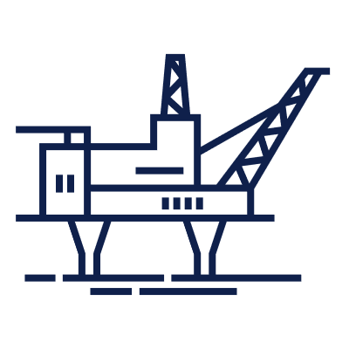
Trust and efficiency based on proven methodologies
Design, building and Production/capture
Asset/storage
Calculation/processing/modelling
Analysis & decision making
Assurance of digital twins
DNV-RP-A204
Data quality management
DNV-RP-0497
Data-driven models and Machine learning
DNV-RP-0510 and DNV-RP-0665
Sensor systems
DNV-RP-0317
Cyber Security
DNV-RP-G108
AI enabled systems
DNV-RP-0671
Asset Information Modelling Framework
DNV-RP-0670 (to be published in Q4 2023)
Notes:
To help the industry overcome challenges and get value from digital investment, DNV has developed a series of recommended practices together with key industry players. These recommended practices take a holistic approach and are being used as frameworks for successful digital transformation across the data value chain from data production to analysis and decision-making.
We provide recommendations for complete digital twins, data and sensor systems, cyber security, data-driven models and machine learning, and AI enabled systems.
The asset information model is the backbone of a digital twin. During Q4 this year we will launch a recommended practice on Asset Information Modelling Framework. This recommended practice builds on the READI joint industry project and subsequent joint efforts between Equinor, AkerBP, Aibel, Aker Solutions and DNV aiming at a format of asset information that will enable computers to read and perform automatic reasoning.

Slide 8
CREATING A SMARTER ENERGY SECTOR WITH TRUSTWORTHY DIGITAL ASSETS
DIGITAL TRUST BY DNV

Slide 9
Thanks for your attention!
kjell.eriksson@dnv.com
+47 95468338

