Slide 1
Profit Improvement through Digital Twins
Future Digital Twin Conference
ETCA, Amsterdam
17 October, 2023
Philippa Hayward, KBC

Slide 2
Agenda
What’s the Objective?
Business goals and barriers
Design considerations
KBC Process Digital Twin
Definition
Use Cases
Case Studies
Where Next?
Wrap Up

Slide 3
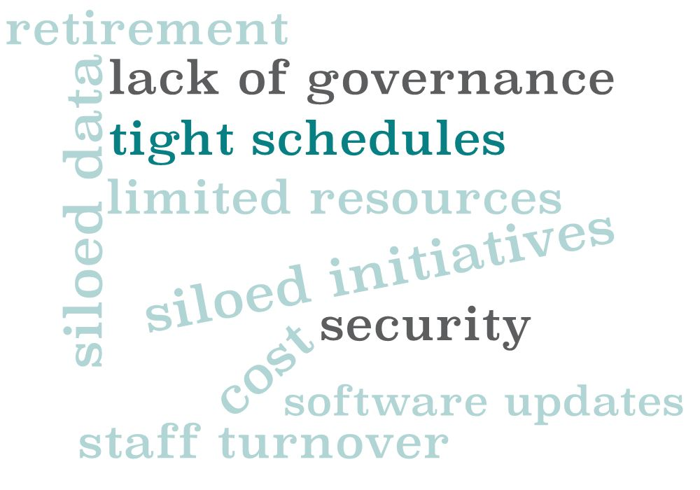
Business Goals and Barriers
Common Industry Challenges

Slide 4
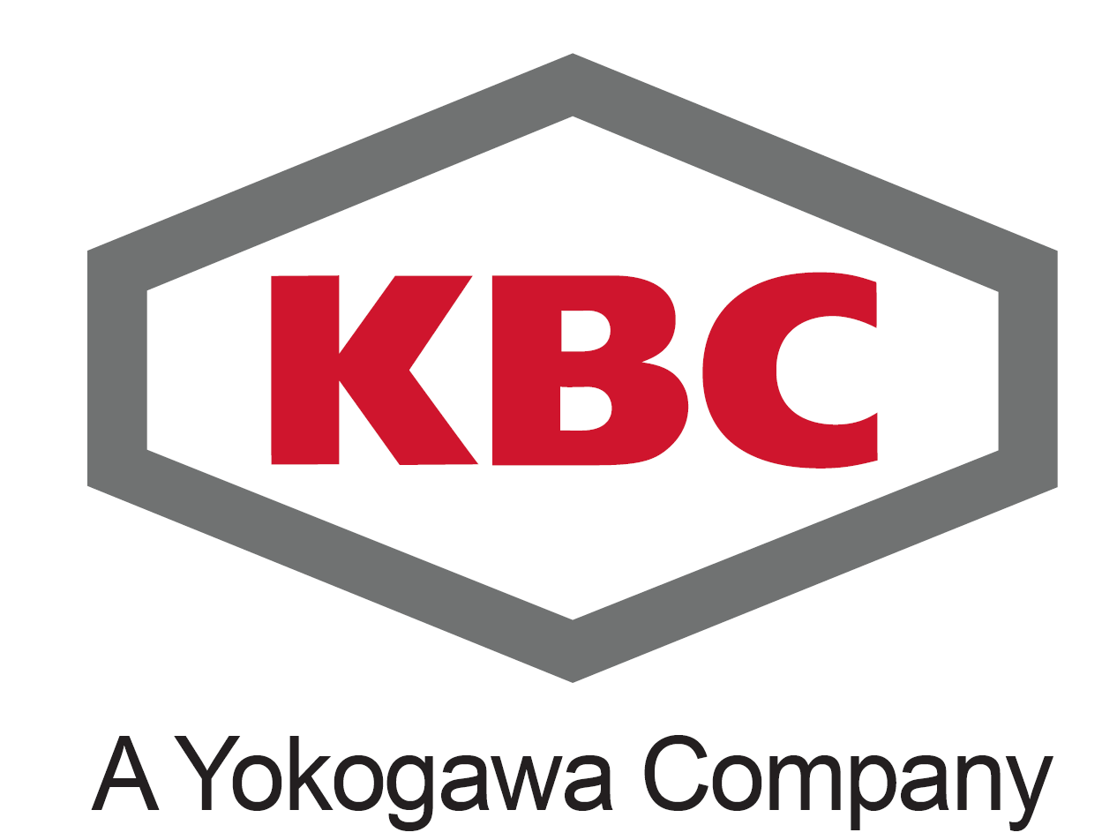
Designing a Digital Twin
Data
World class technology & operational expertize in decarbonization and energy & process management

Slide 5
KBC Process Digital Twin Architecture Overview
Decision Support Outcomes
Data Sources
Role based Visualization and Reporting
Digital Twin
Simulation and Prediction Engines
Data Reconciliation and Management
KBC Technologies
Reactor Models
Equipment Models
Process Models
Flow assurance
Integrated Asset Model
Energy and Carbon models
Physical Asset
Data and Work Process Automation
Digital Asset
5

Slide 6
Process Digital Twin – Use Cases
Estimate intricate KPIs
Deeper analytics
Reconciliation through first principles
Health check of data
Collaborate with peers, 3rd parties
Improve ownership
Profit Improvement
Model Assurance
Visibility of Information
Enhanced Unit Monitoring
Data Reconciliation
Collaboration
Identify additional opportunities
Sustain benefits + quantify gaps
Maintain accurate models
Seamless update of models
Single source of truth
Transparency of info

Slide 7
Case Studies
$ value of missing optimization opportunities automatically exposed across enterprise – improves work prioritization and productivity
Digital Twin model confirms critical control analyzer issue – relieving critical capacity constraint
Corporate expert and site engineer collaborate remotely to resolve poor furnace performance
+$3MM operating profit on refinery conversion unit after identifying unused tower capacity
Multinational identifies mechanical damage to analyzer – constraint lifted on unit - worth $300,000/day
Refiner increases margin by €10MM using a process digital twin to improve planning tools

Slide 8
Where Next?
Visualization
And Reporting
Accessible information, tailored to individual consumers
Data Sources
Automated Model Maintenance
Digital Twin
AI keeps models up
to date and
accurate
Hosted either on-premise or cloud
1st principles models
Real Time Optimization
AI/ML models
On-line gain generator and Optimizer (PACE )
Scope:
Equipment level to Enterprize level
Targeted application to Enterprize standard
Advanced Process Control (APC)
Scale:
Engage:
More users access outcomes
Distributed Control System (DCS)
8

Slide 9
Wrap up
Define your Business Objective
Design your process Digital Twin to:
Minimize barriers
Work with your people, processes and data
Process Digital Twin can deliver significant value
Deeper insights
Automated monitoring, optimization and improved governance
Intuitive, accessible visualization

Slide 10
Thank you for your attention!
Questions?

