Slide 1
Putting Time-Series to Work with Digital Twins and Generative AI
Brian Parsonnet, Founder & Corporate Fellow
Seeq Corporation

Slide 2
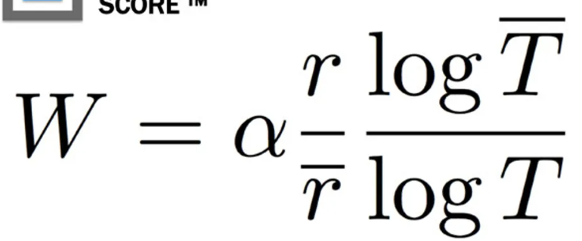
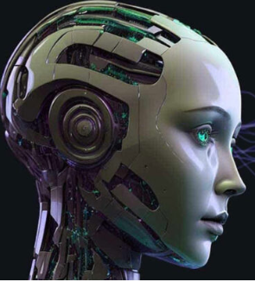
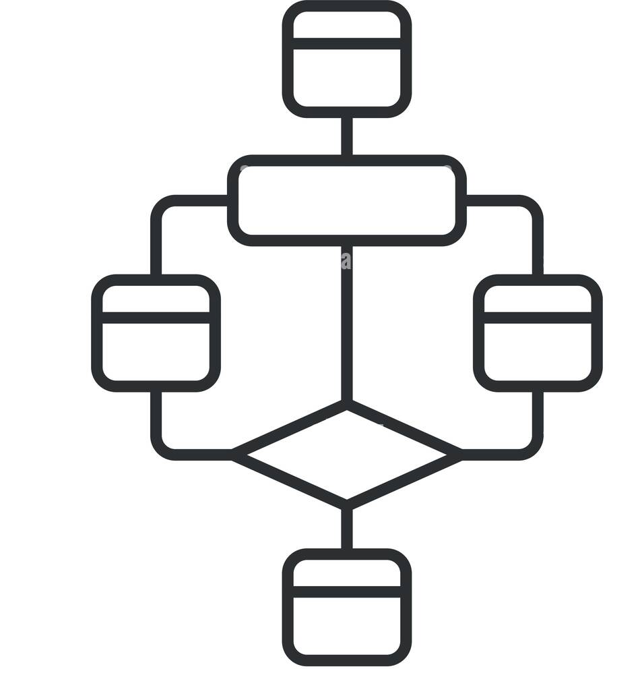
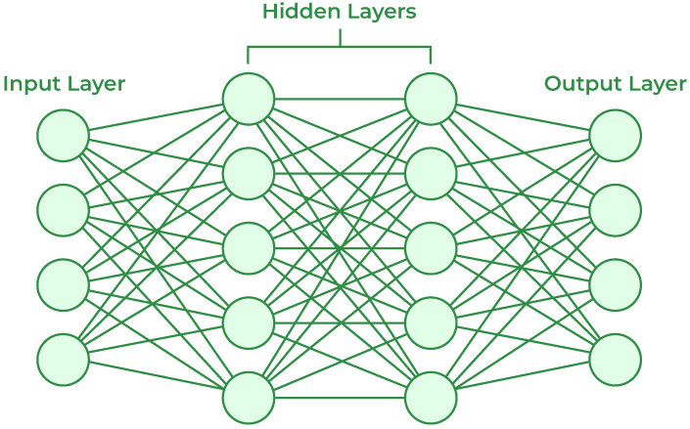
Industrial Enterprise Monitoring ™
Digital Twin
Generative AI
First Principles
Science Speaks
LLM
GAN
GPT
RNN
CNN
AE
Rule-Based
Experience Speaks
Empirical
Data Speaks
Virtual Plant
Sensors
Virtual Person
“Conversations”

Slide 3
Industrial Enterprise Monitoring ™
The Want
Digital Twin
Generative AI
Assist
Assist
€
€
Engineering
Operations
Maintenance
Supply Chain
Optimization
Compliance
Sustainability
∞…

Slide 4
Industrial Enterprise Monitoring ™
The Reality
Digital Twin
Generative AI
Assist
Assist
€ € €
€ € €
Engineering
Operations
Maintenance
Supply Chain
Optimization
Compliance
Sustainability
∞…
Assist
Assist

Slide 5
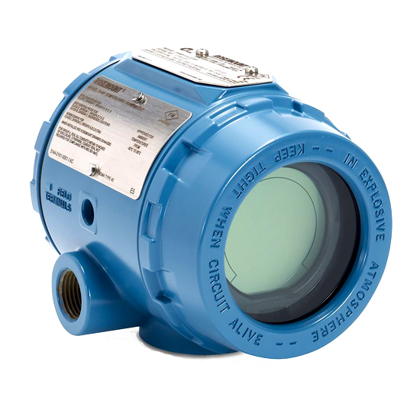
Actual vs. Expected…not so simple!
Everything is changing
Operating conditions
Operating modes and recipes
Operating targets
Process & equipment
Operator actions and shifts
Advanced control
Material changes
Equipment degradation
Sensor drift
Fouling, degradation
Maintenance
Grossly under-sensed, leads to lack of specificity
Action (Repair, Mitigate, Investigate)
Collaboration
Annotation
Situational Awareness
Scale (Config, Triage, Improve/Learn)
Digital Twin

Slide 6
Common Machine Learning Workflow
Extract
Clean
Model
Assess, Rework
Results
Slow iteration
Ideal Workflow
On-line
(no ETL)
Continuous Clean
Model
Assess, Rework
Results
Legend
Fast iteration
IT / DS
SME

Slide 7
Common Machine Learning Workflow
Extract
Clean
Model
Assess, Rework
Results
Off-line, periodic
Repetitive
Lacks SME
Weak Tools
Lacks Context, Scalability
Collab tough,
False pos/neg, Visualization
Not sustainable, not timely, not actionable
Slow iteration
Ideal Workflow
On-line
(no ETL)
Continuous Clean
Model
Assess, Rework
Results
Legend
Fast iteration
IT / DS
SME

Slide 8
Seeq Approach
High-valued, immediate need use-cases provide the critical missing data, methods and context
Seeq’s infrastructure provides the rest (capsules, calc-engine, APIs, scale, access, security, structure…)
Enabling the Ideal Workflow is an intentional by-product
On-line
(no ETL)
Continuous Clean
Model
Assess, Rework
Results
Legend
Fast iteration
IT / DS
SME

Slide 9
Sensor Time-Series is Very Different
Traditional | Sensor Time Series
Transactional, independent events | Continuous, auto-correlated, sampled
Easy to index and search | Impractical to index by value, hard to search
Joins | Joined by time, which requires interpolation (math)
Dimensional cubes | Multivariate analysis
Languages, Semantics | Units, Metric Prefixes
Facts | Precision, Accuracy, Resolution, Tolerance
Clerical errors, syntax | Noise, Flyers, Bias, Calibration
Statistical Analysis, Batch Calculations | Signal Processing, Stream Calculations
Quasi-static meta data | Dynamic meta data
Context self-contained | Context is largely external
Empirical, Rule-based models | Empirical, rule-based, and first principles
Discrete Math | Calculus
Editable | Append only
Lossless compression | Lossy compression
ETL | Streaming + Historic blend
SQL, relational | Purpose built, not SQL, time is a continuous dimension
Archives, Databases | “Historian” market

Slide 10
Increasing value requires unique data sources
What are common root causes for reactor circulation pump failures?
Give me a checklist for investigating problems with a control valve
Create a report for control loop performance
Public info

Slide 11
Increasing value requires unique data sources
What are common root causes for reactor circulation pump failures?
Give me a checklist for investigating problems with a control valve
Create a report for control loop performance
Create a plot of CV-101’s Flow Coefficient vs. an empirical model
Build me something that will detect a change in CV
Public info
Tools info

Slide 12
Increasing value requires unique data sources
What are common root causes for reactor circulation pump failures?
Give me a checklist for investigating problems with a control valve
Create a report for control loop performance
Create a plot of CV-101’s Flow Coefficient vs. an empirical model
Build me something that will detect a change in CV
What are the likely causes for CV-101 oscillation?
What were the last few problems with CV-101?
How should I clean this signal?
Who should I talk to about problems with this compressor surge?
How are we monitoring pump P-556?
What are the top 10 process issues in the plant today?
Corporate Knowledge Base
Tools info
Relationships
Case history
Time-series
Workflow
ALL tools
Prioritization
The Missing Context!!

Slide 13
Industrial Enterprise Monitoring
“Pump cavitation occurs 14 minutes after column temperature inversion”
Analytics, Reports, OEE, Triage, Search, Monitoring, Alerting…
Generative AI
Fast ROI Use Cases
Semantic Layer
Auto Knowledge Capture
Models, Relationships, Context, Prioritization Cleansing, Assets Structure, D-Twin, Usage, Conditions…
Seeq Cortex
(No ETL, Scale Time-Series Calc Engine, Capsules…)
Time Series
Historians
Manufacturing
Data
AssetData
ERP, CMMS…

Slide 14
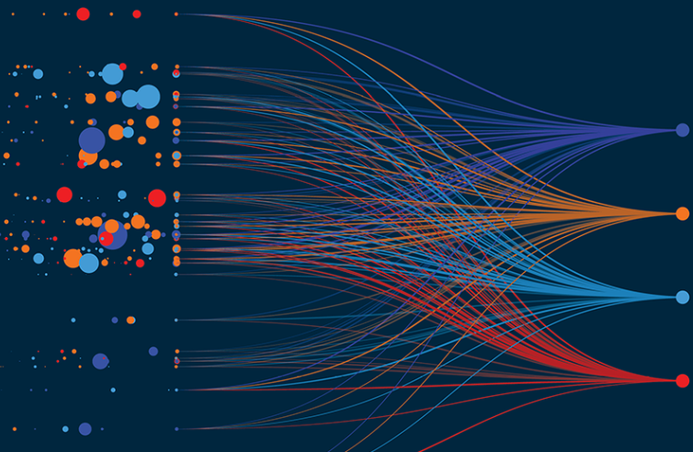
Industrial Enterprise Monitoring
Q: Why is PT-504 oscillating?
A: CV-101 has increased friction
Digital Twin
Fast ROI Use Cases
Alerts
Assist
Phys Prop
Predictions
Synthesize
Prioritize
Code
Triage, Investigate, Fix, Mitigate
Sustainability
Unique & Essential Content
Semantic Layer
Cont. Improvement
Dynamic Context
Scale Configuration
Understanding of:
Time-Series
Relationships
Patterns
Relationships, History,
Time-series, Workflow, Open Ecosystem, Prioritization, Usage Data, Capsules
Enabling the Subject Matter Expert is the Critical Success Factor

Slide 15
Thank You!
Brian Parsonnet, Seeq Corporation

