Slide 1
Bridging the gap between technology and transformation
Future Digital Twin, Amsterdam
Rob Kennedy Global Director, Digital Twin Solutions
October, 2023

Slide 2
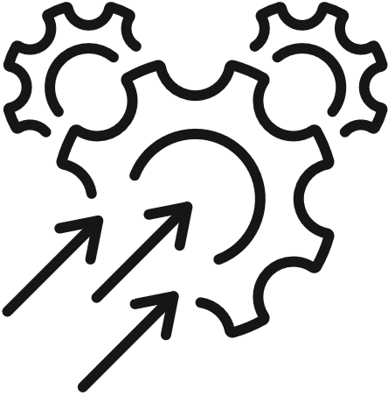
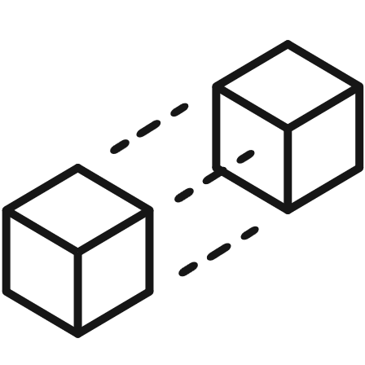
Decoding digital to transform industry
Energy.
Oil & gas | Hydrogen | Carbon capture
Materials.
Minerals | Chemicals | Life sciences
Decarbonisation
Digitalisation
Digital Solutions
Asset Health
Increasing uptime and extending assets
Process Optimisation
Optimising resources and driving efficiency
Decarbonisation
Accelerating the energy transition
Digital Twin
Enabling lifecycle transformation
System Integration
Architecting our clients’ digital ecosystems
Notes:
One of world’s leading consulting and engineering companies > 35k people > 60 countries
Energy and Materials markets > delivering solutions to critical challenges > Consulting, Projects and Operations expertise.
Wood is also driving Decarbonisation and Digitalisation across these markets.
Helping clients to reach net zero through sustainable design and operations.
[***CLICK***]
Wood is also a leading independent partner for digital transformation
We bring together domain knowledge, digital expertise and decades of experience designing and operating our clients’ assets.
Digital twin is one of our 5 core digital solutions, and is the holistic lens through which we drive transformation across the asset lifecycle.
[1:30]

Slide 3
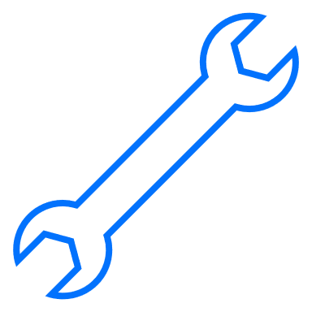
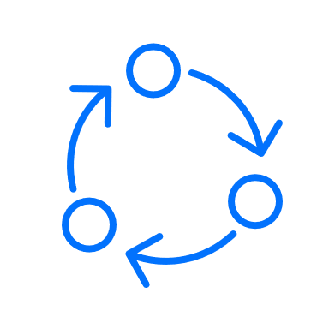
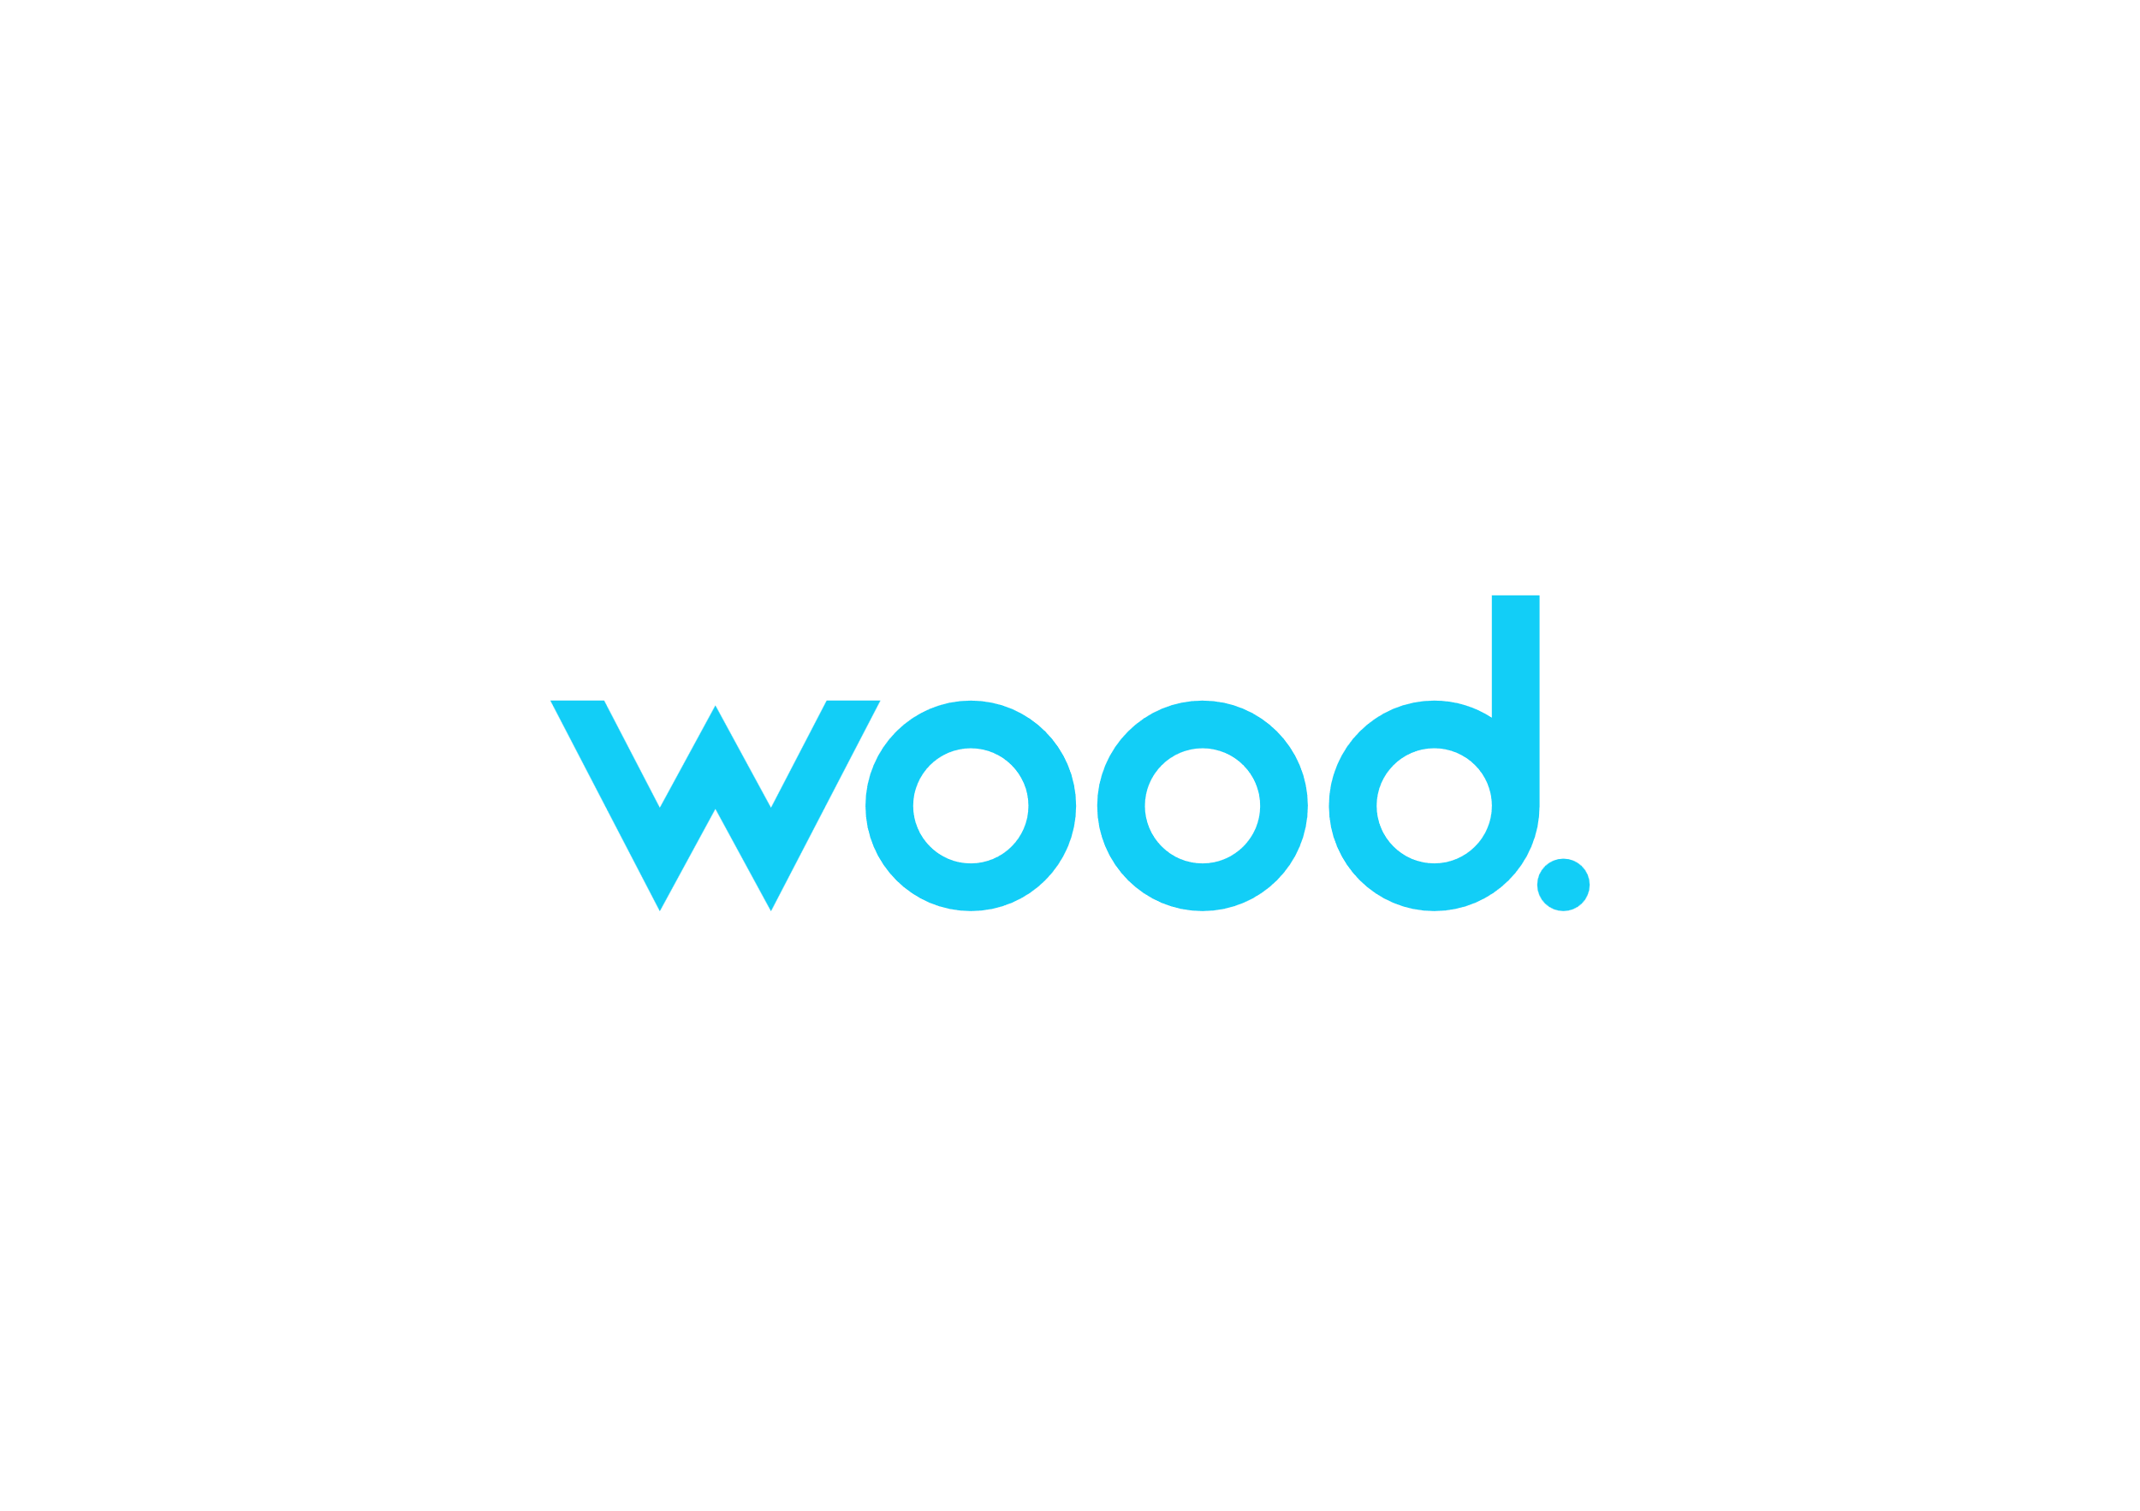
Driving business outcomes
Value outcomes from Wood projects:
$1.1Bn Design risk mitigated on a Middle East mega-project
67,000 Hours of overdue maintenance backlog, and 45,000 hours per annum of forelog removed
1,200+ per annum Offshore days removed in the North Sea by enabling work to be performed from shore
Enhance worker safety
Increase workforce efficiency
Optimise maintenance & increase reliability
Boost operational efficiency & production
Enable sustainability goals
Business
Portfolio
Asset
System/ Class
Equipment
 | Data | Information | Insight | Decision | Action
Notes:
As an industry, we are looking for digital twins to increase performance across our assets and businesses.
Asset owner/operators have a wide range of needs which they are addressing using digital twins.
By and large, how the industry is using digital twins has matured greatly over the last number of years.
[***CLICK***] Framework to assess how we are using and driving value from digital twins
Horizontal axis captures the spectrum from data to information, insight, decision, and ultimately action
The vertical axis looks at the scale across the organisation – from individual equipment, classes of equipment or systems, all the way to business
[***CLICK***]
IN GENERAL: Digital twins providing insights at equipment and system level
While this speeds up decision making and increases its effectiveness, we are still relying on humans to make the decisions and take action.
And we do have more work to do to more effectively leverage digital twins at the portfolio and business level
[***CLICK***]
Numbers on the right from some recent Wood projects.
Indicative of the outcomes that can be realised by digital twins, when successful
But judging the maturity of the entire industry on good outcomes alone paints a misleading picture.
Anecdotally: large number of digital twin projects continue to fail to deliver the promised return on investment.
[4:30]

Slide 4
Beyond the hype
2 | 0 | 1 | 8
2 | 0 | 1 | 9
2 | 0 | 2 | 0
2 | 0 | 2 | 1
2 | 0 | 2 | 2
Innovation trigger | Peak of inflated expectations | Trough of disillusionment | Slope of enlightenment | Plateau of productivity
Gartner, 2018. Hype Cycle for Manufacturing Operations Strategy, 2018.
Gartner, 2022. Hype Cycle for Manufacturing Digital Transformation and Innovation, 2022.
Notes:
Recognise Gartner’s hype cycle
Paints a more realistic picture of where we are as an industry
[***CLICK***]
2018: Innovation Trigger > Peak of Inflated Expectations > 2022: Trough of disillusionment
Over 5 years > proven the technology at increasing scale > created significant expectations around its potential.
Descent into ‘Trough of Disillusionment’ > not due to technology failings
Failure to effectively transform the business in light of the new technology
To be successful we need to address more than just the technology alone
I would question whether we are neglecting:
People – competency, organisational transformation
Processes – ways of working
And to a lesser extent – the underlying data we need through the lifecycle
[6:00]

Slide 5
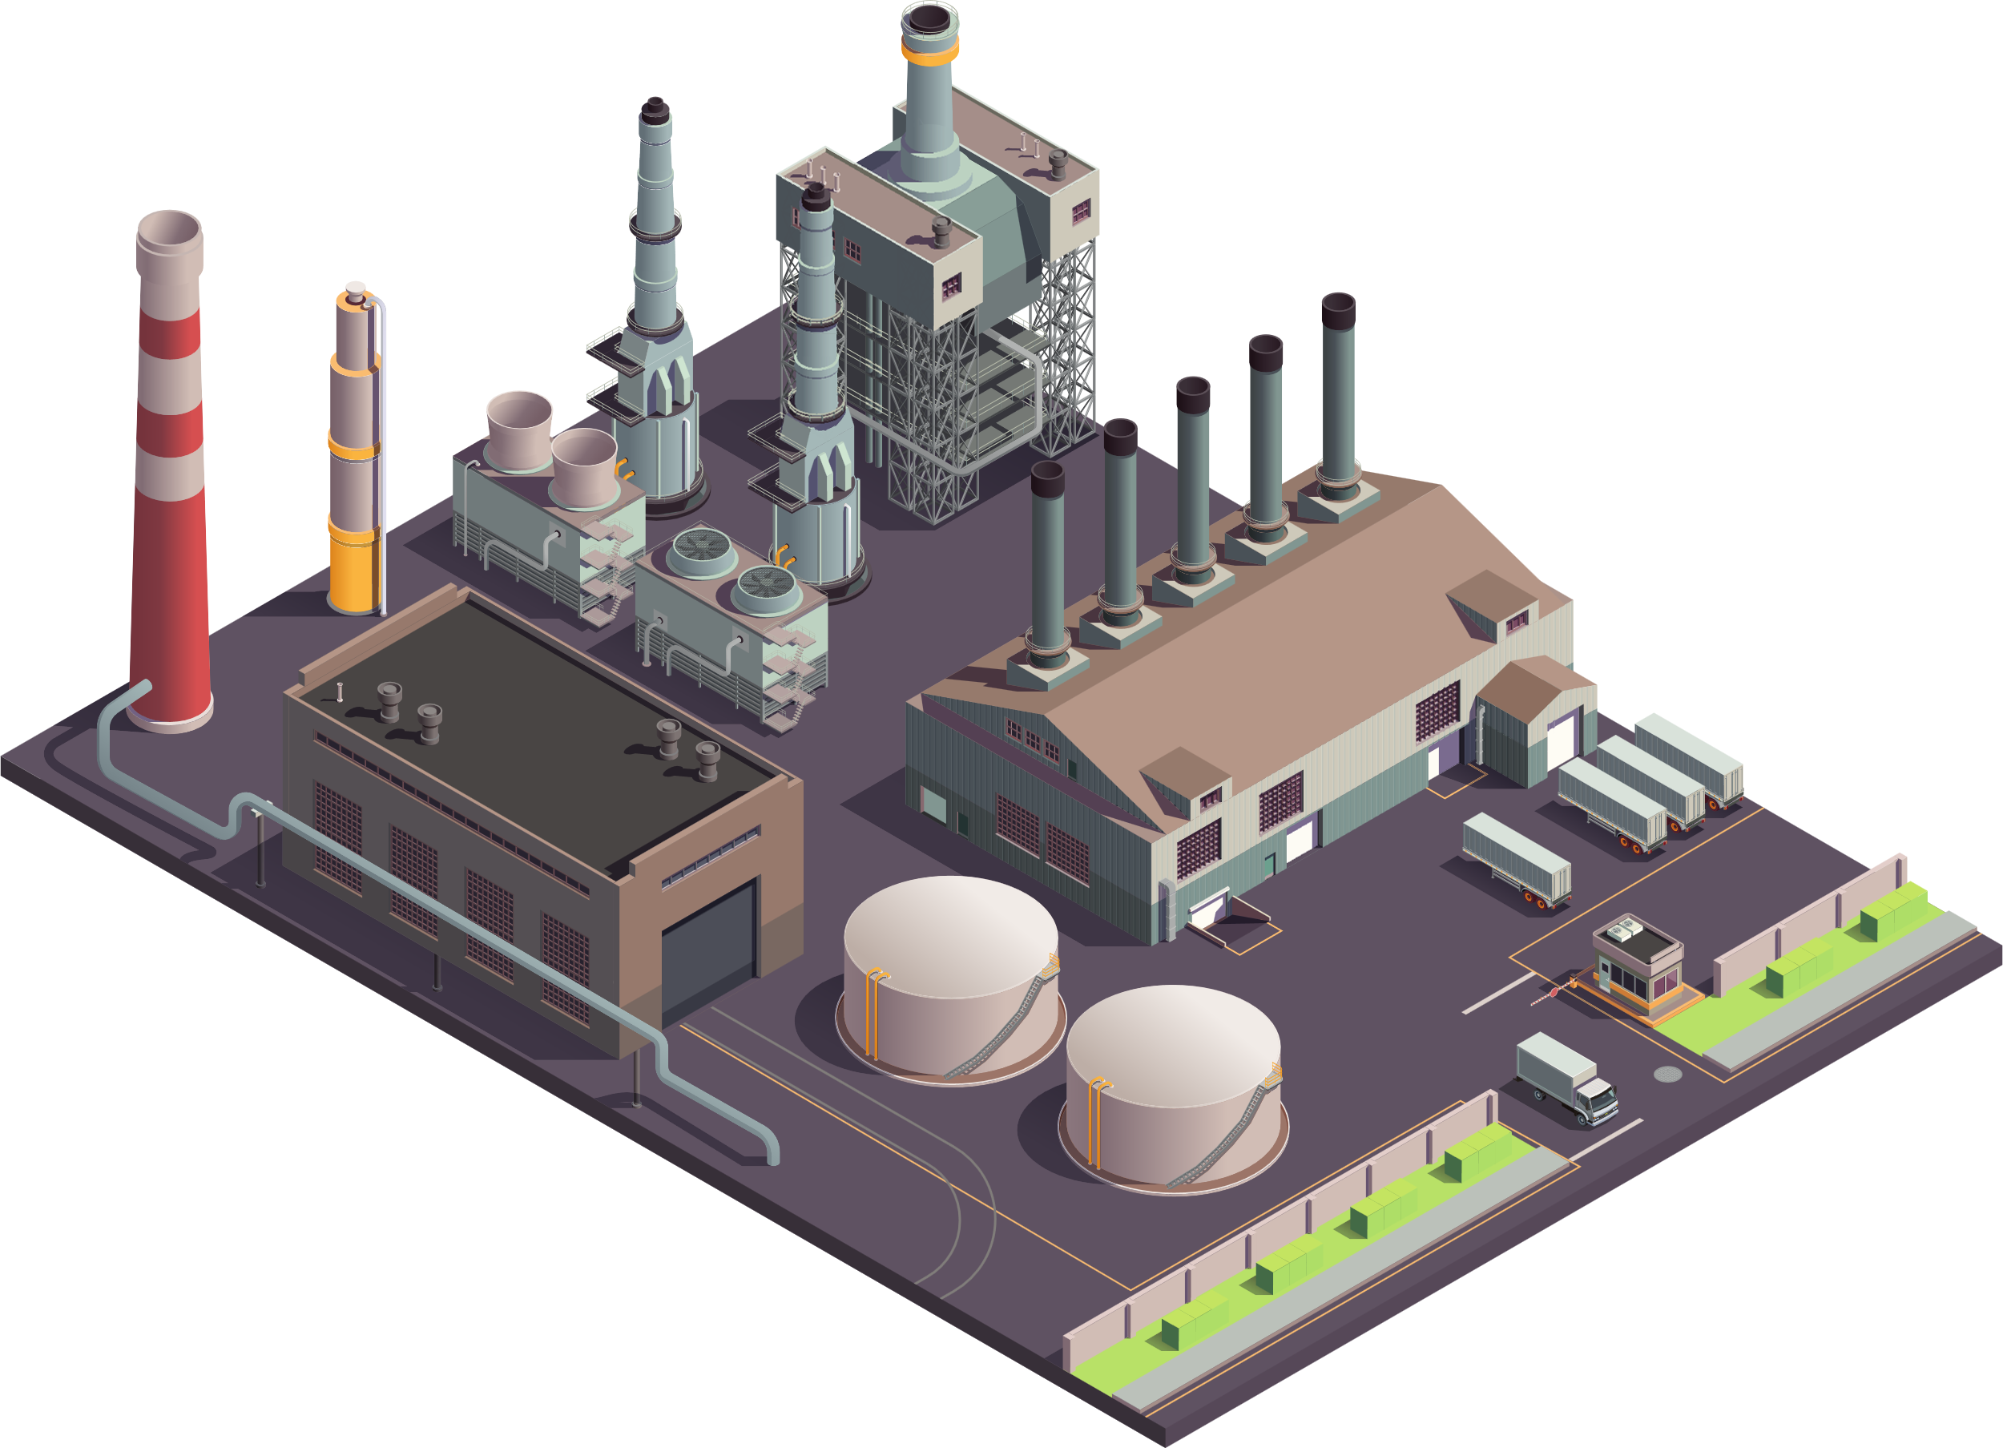
It’s about to get much more complex…
↓$
Feedstock
↓$
Natural gas
$
Product
↓$
Electricity
↓$
Asset design, construction & maintenance
Notes:
Clearly, we still have a way to go
But, if there was ever a need to accelerate our progress, you only need to consider the effects of energy security and the energy transition
We all know that supply chains and the value chains of our businesses are going to continue to become more complex and dynamic
Example: Refinery
[***CLICK***] Today – reasonably easy to understand and quantify.
Feedstock comes in at a given specification and cost
Natural gas may be used for heat and power
Electricity comes from the grid with a perhaps an unknown mix of conventional and renewable sources
We also need to understand the capital and operating costs for the asset
All of this is reflected in the cost to produce the product
And profit is dictated by this and the sell price of that product in the market at that time
[7:30]

Slide 6
It’s about to get much more complex…
↑$
↓CO₂
Carbon capture & storage
↑$
↓CO₂
Carbon credits
↓$
↑CO₂
Conventional feedstock
↓$
↓CO₂
Bio- feedstock
↓$
↑CO₂
Natural gas
$
↓$
↓CO₂
Hydrogen
Product
CO₂
Reduced emissions
vs. increased cost
↓$
↑CO₂
Conventional electricity
↓$
↓CO₂
Renewable electricity
↓$
↑CO₂
Asset design, construction & maintenance
Notes:
Consider then a refinery in the very near future
Cost is no longer the only driver – carbon is just as important
Feedstock now blend of conventional and bio-feedstock
Our energy is now sourced from a mix of conventional and renewable sources – each with their own cost and emissions profile
Carbon needs to be mitigated, through CCS
Finally, we may not just produce our product, but may also produce hydrogen
Our product now has – not just a cost to produce – but also a carbon footprint. And customers will no longer just purchase that product based on cost, but on the cost and the carbon intensity.
The complexity has increased substantially.
Increased dynamics > optimise the operation: minutes to hours (before days and weeks)
Volume of decision and actions – going to need digital twins to help us operate and be profitable in this new paradigm.
[9:30]

Slide 7
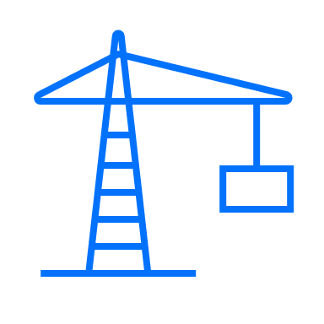
Building digital-native assets
Plan >
Design >
Build >
Operate/Optimise >
Repurpose/ Decommission
Right-to-left thinking
Technology will continue to advance – we must accelerate transformation
Notes:
How do we accelerate progress > overcome transformation challenges we’re facing?
Biggest opportunity to drive change: sits within capital projects – both greenfield or major brownfield projects.
[***CLICK***] Asset owners > consider lifecycle digital twin strategy or digitalisation strategy at preliminary engineering stage
Wood applies an approach called “right-to-left thinking” to define the lifecycle needs, and reflect these back into the lifecycle digital strategy for the asset.
Opportunities: improve asset performance, productivity, and ultimately profitability
However, by the time we consider digital transformation, the asset concept has already been defined and selected
Made numerous assumptions around the operating philosophy for the asset. Without considering the potential impact of digital transformation and digital twins.
Too late to have the magnitude of impact that we want.
[***CLICK***] What impact would it have if we considered digitalisation from the very inception of a concept?
Different asset design? > Material impacts on key assumptions that drive lifecycle economics?
Or – perhaps most relevant to this discussion – how might it impact the business processes, the ways of working and the very people we need to safely, reliably and profitably operate the asset?
We need to stop retrofitting digital twin to the asset concept, and make it an integral part of that concept.
We all know the pace of technology progress will continue to accelerate. But unless we start to tightly integrate digital transformation into the very core of our business processes and our assets – right from their inception – the gap between technology and transformation will continue to widen.
[12:30]

