Slide 1
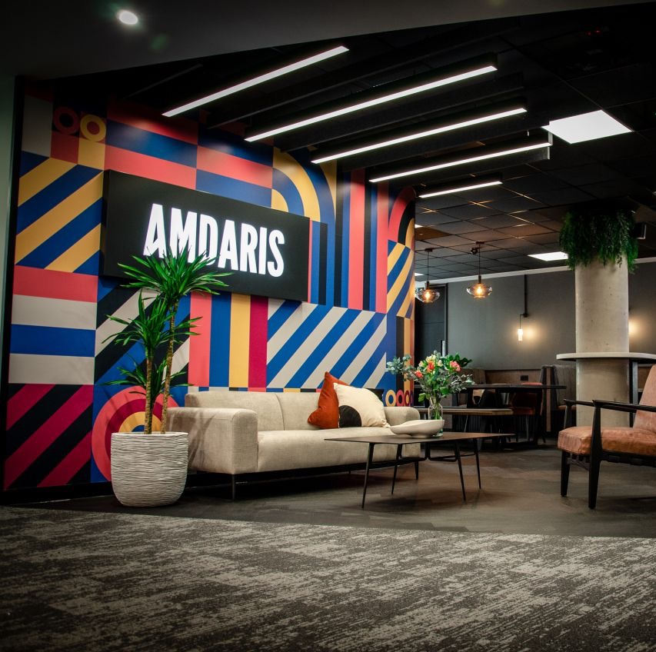
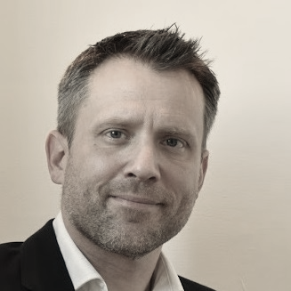
Imagine the Impossible
Matt Lee
Chief Delivery Officer
Amdaris

Slide 2













The 3 Key Software Challenges in 2024
Transformation initiatives using latest tech to drive business value
Finding sufficient talent with the right skills and capabilities
The need to modernise legacy applications and technologies
92%
of enterprises are either currently modernising critical applications or plan to in the future
Only 30%
of companies in Oil and Gas have been able to successfully scale digital transformation
The gap between available talent and open positions is expected to widen further in 2024
79%
of application modernisation projects fail with an average cost of $1.5 million
70%
of digital transformation projects fail to deliver expected value
56%
of organisations are struggling to find appropriately skilled developers

Slide 3
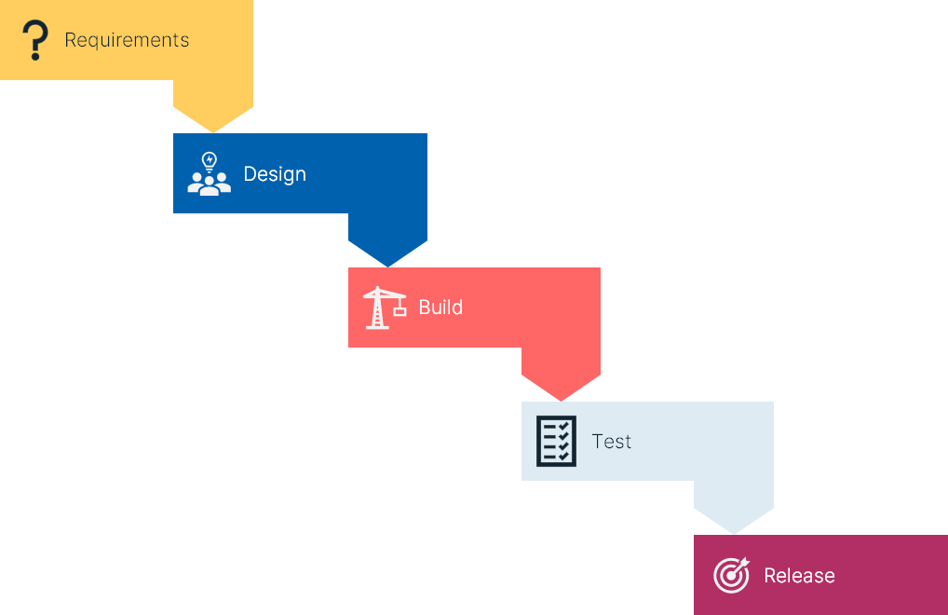

Why do transformation projects go wrong?
(Fixed Price) Waterfall
Unless the scope of work is really clear, prices aren’t really fixed
Changes to scope =
cost uncertainty and delays
Often results in conflict / disagreement
(T&M) Agile
Drives a more collaborative approach
Changes to scope easily dealt with
Can often result in uncontrolled costs and timescales
Wagile
A Fixed Price with the flexibility of Agile…
Tends to result in a marriage of the worst parts of both approaches

Slide 4



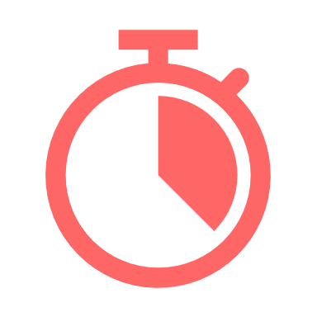

Can you imagine…
Innovation and the latest technology
Digital transformation consistently delivering value
Teams with the cutting-edge skills and capabilities
No legacy technology and no technical debt
Transformation programmes on budget and on time
Motivated and highly productive tech teams aligned with company values
…the impossible???

Slide 5


Achieving the Impossible
5 Things we’ve Learned
5: Technical
Excellence
4: Systematic Measurement
and Optimisation
1: Value First
3: Proactive
Improvement
2: Proactive Governance
and Transparency
Key Results
1
Transformation programmes delivering true value
Transformation programmes delivering to plan & budget
Agile
Best Practice
2
Agile
Best Practice
3
Major issues eliminated & legacy technology minimised
Top Tier
Talent
First Class
Tooling
4
Optimised & Efficient Operations
5
Innovative Use of Latest Tech

Slide 6




Achieving the Impossible
Modernising a legacy technology landscape
Business Challenge
Business Value Delivered
Poorly performing, unreliable critical business applications
Transformation hindered by Legacy Technology
Need for modernisation without disruption
Significant Technical Debt
Reduced total cost of ownership
Improved efficiency for customers
Significantly Improved Business User Satisfaction
The teams that Amdaris provided are very technically savvy. There’s good relationship management through the cycle to get the tools to a place where they’re technically supportable, secure and relevant.
CIO, Oil and Gas Company
“
How Amdaris Helped
Reduced legacy bugs from
Modernised and Migrated Applications to Cloud
Delivered numerous Transformation projects on time and on budget
300 to zero
In 12 weeks

Slide 7
Thank You
88
Client NPS
154
Projects Successfully
Delivered in last 12 months
92%
Employee retention

