Slide 1
Winning by becoming 2nd
Creating real value by adopting proven Digital & GenAI uses cases
Tandon Oberoi & Esther Diederen
June 2024

Slide 2

Digital and AI has already proven significant value in Upstream O&G
There are already many examples of digital value delivered across the upstream industry.
Emissions Reduction & Low Carbon Operations
Exploration
Advance analytics
Cloud based processing
Wells
Digital twins
Automatic drilling
Industry Challenges
Support Functions
Automation
Digital workplace
Shortage in Critical Skills & Competency
Capital Projects
Construction digital twin
Automated data extraction
Ops &
Maintenance
Operations Efficiency, Cost & Margin
Real time
production reporting
Predictive
maintenance

Slide 3

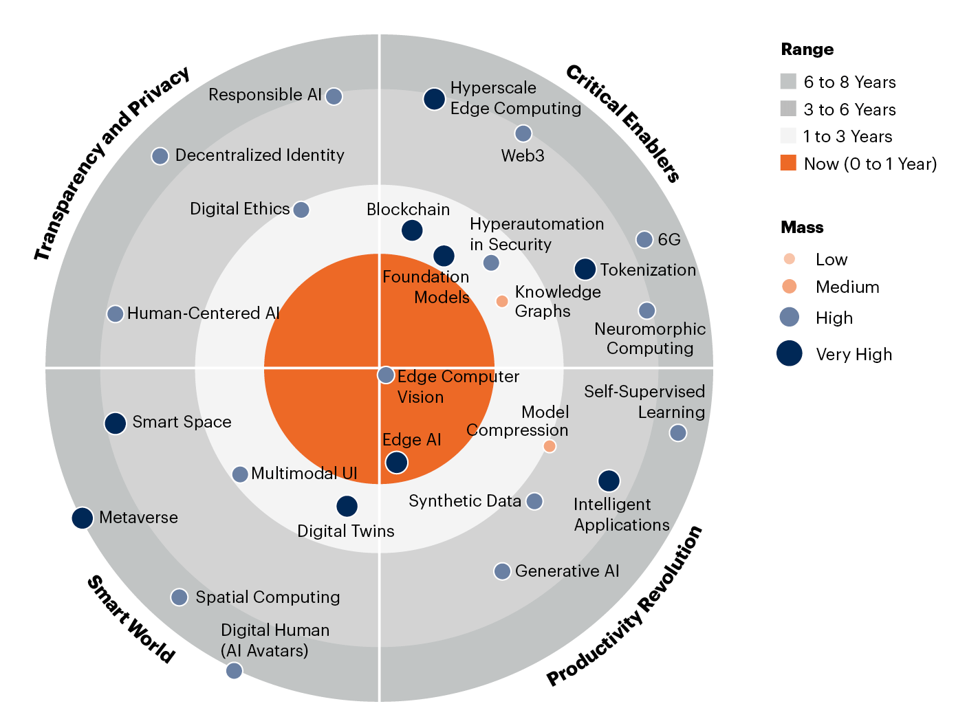

However, most AI use cases are not yet ready to deliver business value
Look out for valuable opportunities but watch-out for the GenAI hype.
GenAI: Peak of suite of AI tools as well
Hype Cycle for Artificial Intelligence, 2023
2023 Gartner Emerging Technologies and
Trends Impact Radar
Smart Robots
Generative AI
How do we accelerate to plateau of productivity?
Responsible AI
Neuromorphic Computing
Prompt Engineering
Foundation Models
Artificial General Intelligence
Synthetic Data
Decision Intelligence
Model Ops
AI TRiSM
Operational AI Systems
Composite AI
Expectations
Data-Centric AI
Edge AI
AI Engineering
AI Simulation
Computer Vision
Causal AI
Data Labeling and Annotation
Neuro-Symbolic AI
Knowledge Graphs
Cloud AI Services
Multiagent Systems
Intelligence Applications
First-Principles AI
Autonomous Vehicles
Autonomic Systems
AI Maker and Teaching Kits
As of July 2023
Innovation Trigger
Peak of Inflated Expectations
Trough of Disillusionment
Slope of Enlightenment
Plateau of Productivity
Time
©2024 Gartner

Slide 4



GenAI can increase the Value and Adoptability of proven Digital Solutions
GenAI is one of many digital solution but most valuable when used to augment other solutions.
Existing & Proven
Digital & AI solutions
How GenAI can increase the value & adoptability of existing solutions
RPA
Mimics human intelligence
Improves digital adoption
Performs “creative” processes
Digital Twin, AI, machine learning, advanced analytics
Mobile connected worker tools
Accelerates info gathering, summarizing
Creates new content
Search engines, graph databases
Can improve data

Slide 5
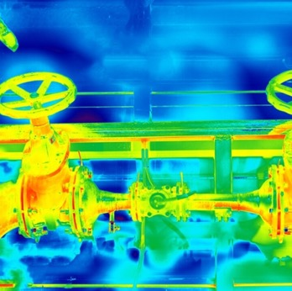
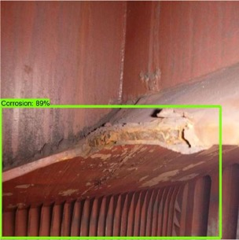
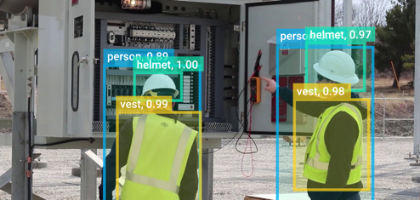
There are examples of true AI and GenAI solutions that haven proven in the industry to deliver value and or reduce cost
Machine Vision
Corrosion inspection
Leak/methane detection
People movement
Chatbots
Automatic interrogation of
company’s documentation
Create decision documentation etc.
Machine learning
Predictive maintenance for e.g.
pump performance
Integrated risk determination
& scheduling
Intelligent process automation
Contract life cycle management
Intelligent buying

Slide 6
Being in the early or late majority maximises likelihood of delivering real value
In this mature basin speed to value is essential. Medium sized operators benefit from a ‘fast follower approach.’ Coming second to win.
Penetration of Target Market
Being a fast follower:
Allows you to adopt the successful pathways created by Innovators and first movers in adopting GenAI.
The number of iterations it takes to get the use case right in
terms of investments and efforts.
The direction of innovation and visibility of the known-unknows
is far greater.
Time to market and ROI is achieved potentially within a short time-frame.
Allows you to look at GenAI adoption from a performance improvement/revenue generation along with cost reduction.
10%
Laggards
40%
Late majority
40%
Early majority
10%
Early adopters
2.5%
Time
Innovators

Slide 7






Though… In order to be able to compete and become second…
You will have to:
Train, alone and with your team!
Be fit and eat healthy.
Know the risks of the game.
Have the right equipment.
And make sure you have supporters to cheer you on!

Slide 8
To maximise value in mature operations, digital strategy should be focussed on the specific value areas of late life operation
There are many ‘gotchas’ connected with the enabling technologies with the risk to reduce value or derail the digital strategy into technology ‘dead ends.’
Sample of high value cases
Late life operation through to decommissioning
Making the right timely decision to enter late life. | Improved integrity insight to set integrity mgt work to optimal level. | Rapidly optimize production to maximize remaining value. | Automate for efficiency in supporting functions in line with production. | Automate for efficiency in supporting functions in line with production. | Connect field workers and automate for operational efficiency. | Aggregation of information from disparate historic sources to reduce cost pre-decom.
Typical technologies
– and areas to watch out for
Key digital technology areas and major ‘gotchas’
Digital Twin | The starting point for digital twin is key, digital twin is a broad field spanning a huge variety of types of twin and it can be hard to bridge across these once started within one type of twin. | Intelligent Automation | Automation technology such as RPA can become a sticking plaster on poor underlying tech so shouldn’t be looked at in isolation but as part of an overall information integration and workflow approach.
Analytics / GenAI | Data hungry and effort intensive to build custom models, so needs to be targeted at the highest value problems where trusted data sets exist. | Connected Worker | Many initiatives fail as they focus just on trialing the mobile tech. Need to start with a process optimisation mindset and team with the assets to improve work practices through the mobile products.
!
!
!
!

Slide 9


Digital enablement can bring significant value by improving performance and ensuring sustainability. A focussed approach can still bring value in mature basins and late life operations, while setting up for ‘digital by default’ in new areas like Hydrogen & CCUS. However, to realise value a change in approach is required.
We need approaches that shortcut to value in a cost constrained environment, and are much more human, team and process centric and while GenAI is clearly at the top of the hype cycle, a focussed fast follower approach can unlock value in proven use cases.
Key Takeaways
There are many examples of digital value delivered across the upstream industry.
There is proven value putting ChatGPT-style conversational AI on top of existing Data & Digital Tools – No need for Proof of Concepts!
Build your strategy around the right use cases and proven Technologies. Now is the time to Win by coming Second

Slide 10






Thank you
Get in touch with a member of the team to find out more
Baringa team at the conference
Our newsletter
Andrew Mercer
Expert in digital,
data & technology
Caroline Theodore
Expert in decarbonisation
& digital emissions
management
Esther Diederen
Expert in digital & GenAI
Strategy transformation
& change
Tandon Oberoi
Expert in intelligent
asset data strategy
Energy & Resources Briefing
Subscribe to access our
latest articles, events,
videos and podcasts

