Slide 1
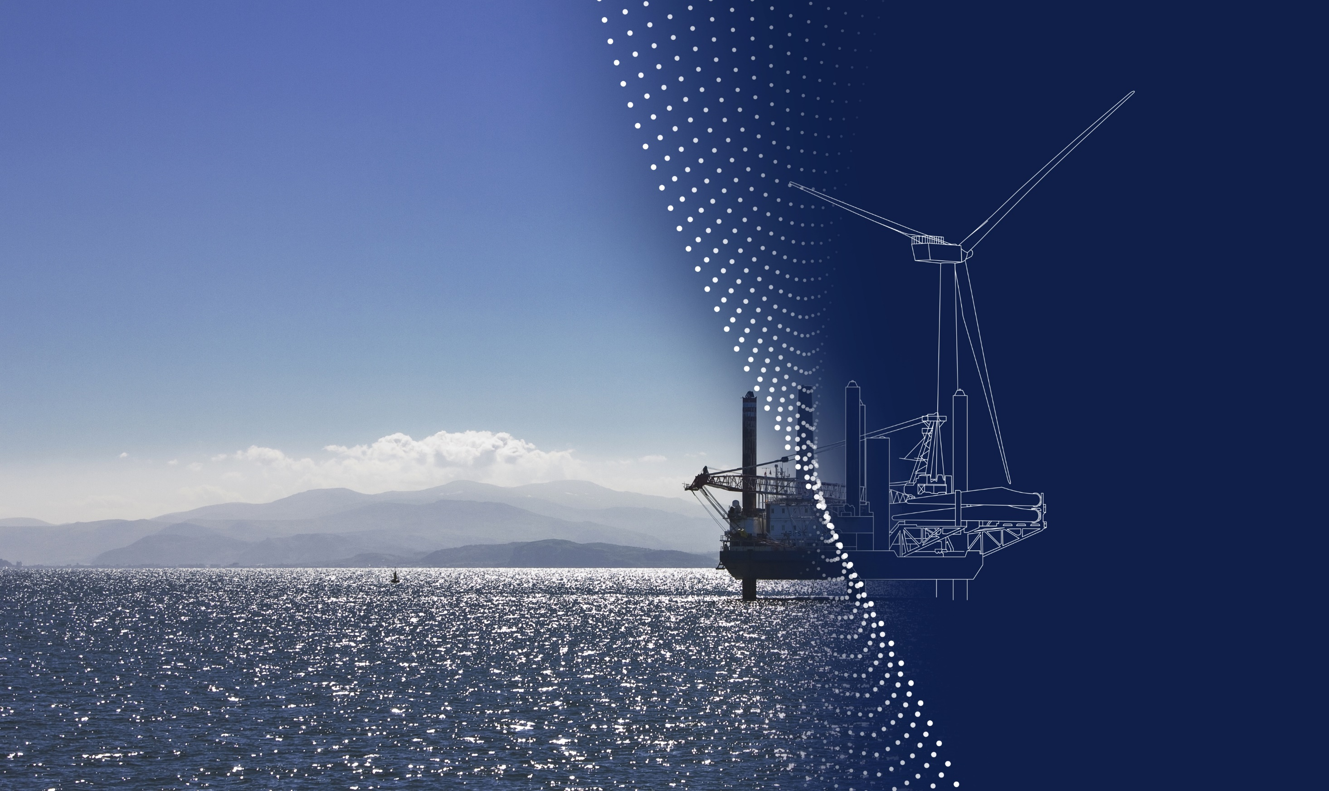
DIGITAL TRANSFORMATION
Energy Insights – Challenges – Digital Trust
Lars Meløe
June 25th 2024
Notes:
For critical infrastructure in the energy industry

Slide 2
An independent assurance and risk management company
160
years
~15,000
employees
100,000
customers
100+
countries
5% R&D
of annual revenue
Ship and offshore classification and advisory
Energy advisory, certification, verification, inspection and monitoring
Management system certification, supply chain and product assurance
Software, platforms and digital solutions
Notes:
DNV is a global independent assurance and risk management company. We have close to12,000 employees and operate in more than 100 countries. We pride ourselves on our uncompromising standards of quality and integrity wherever you meet us around the world. We enable our customers and their stakeholders to manage risk and complexity with confidence.
For Maritime customers, we offer classification services and advisory services with the aim of enabling our customers to safely tackle the ongoing decarbonization and digitalization journey.
In the energy market we assure that energy systems work safely and effectively through monitoring, verifying and advising on the energy infrastructure through the full concept, finance, design, build and operating cycles. As such, we have a global bearing on the pace and nature of decarbonization.
We are a leading supplier of Management System Certification and supply chain assurance services across industries with a particular focus on the food, health and automotive sectors.
We offer software, platform, cyber security services and other digital solutions mainly to the maritime, energy and healthcare sectors.

Slide 3
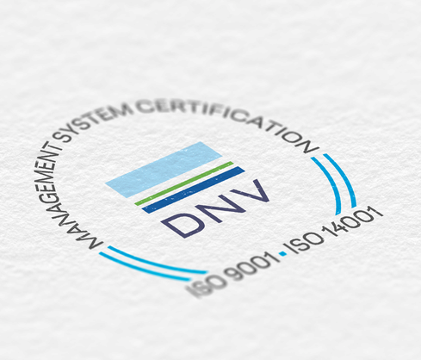
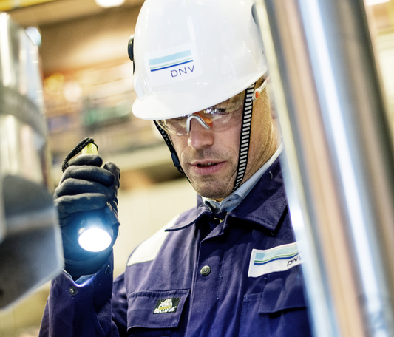
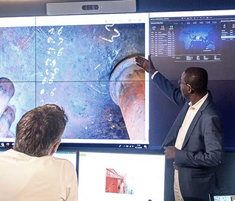
Enabling our customers and their stakeholders to manage risk and complexity with confidence
Certify, verify and test against standards, specifications and regulatory requirements
Qualify and assure new technologies, systems, data, platforms, supply- and value chains
Give expert advice on safety, technology and commercial risk, and operational performance
Co-create and share new rules, standards, software and recommended practices
Notes:
By assurance we mean either overseeing that systems, products, processes or digital assets work safely, effectively and efficiently or providing advice so they may do so.
Through these activities we in DNV enable our customers and their stakeholders to manage risk and complexity with confidence.
Assurance is therefore the fundamental value created as a result of the services we deliver to our customers. These services include:
Certification, verification and testing
The co-development and creation of new rules, standards, recommended practices and benchmarks
The qualification and assurance of new technologies, data, platforms, and supply chains; and
Giving expert advice on safety, technology, risk and operational performance, and sustainability.

Slide 4
Digitalization in the energy industry

Slide 5
Digitalization as key enabler for the energy transition
91% Will increase or maintain investment in digitalization in the year ahead
68% Advanced use of data is changing the way we work at my organization
71% Will prioritize improving data quality and availability in 2024
Source: Digitalization in the energy industry: The views of the C-suite, DNV 2023. Percentages reflect net agreement statements.
Notes:
Data is the fuel powering digitalization, which in turn enables the energy transition the industry so desperately need.
The energy industry do to a large extent agree that digitalization is crucial to managing the burgeoning complexity of the new energy system, where multiple inputs must be integrated and numerous processes need to be automated to ensure services are reliable and resilient.
According to DNV “Digitalization in the energy industry” report where C-level executives across power, renewables, oil and gas and industrial energy use sectors share their views on the energy transition and digitalization, a total of 91 % of respondents will increase or maintain investment in digitalization in the year ahead.
These digitalization priorities reflect increasing importance of data driven strategies and automation, and not surprisingly, 71 % reports that improving data quality and availability is a key priority for the next year. As the industry is increasingly making decisions based on large data sets, it is critical that they have control of data quality.

Slide 6
Huge potential, but hard to get it right
12 %
Organizations in advanced stages of AI development
73%
Organizations piloting or planning AI activities
Source: Digitalization in the energy industry: The views of the C-suite, DNV 2023. Percentages reflect net agreement statements.
Notes:
The industry is investing significant amounts into AI and other digital technologies but few can demonstrate the trustworthiness of these technologies to stakeholders for critical decision-making. The rise of artificial intelligence is about to become a game-changer for the energy sector. Undoubtedly, various AI solutions will be crucial for digital transformation. The energy sector has already developed good modelling systems to handle advanced data. However, it's difficult for humans to get all the relevant insights from the modelling systems. By using artificial intelligence, we can get more value from the data we already have, and it will be possible to discover connections that are difficult for humans to identify.
Organizations in advanced stages of AI development Although only 12% of the industry's C-level respondents say they are in an advanced stage of development – or have live AI projects – this is set to change.
Organizations piloting or planning AI activities 73% stating they are piloting or planning activities for the future.
What seems to be a struggle for most companies is to get from piloting to project implementation.

Slide 7
Biggest barriers to digitalization
Cost of digital technologies
Resistance to change
Lack of digital skills
Lack of investment
Cyber security risk
Source: Digitalization in the energy industry: The views of the C-suite, DNV 2023. Percentages reflect net agreement statements.

Slide 8
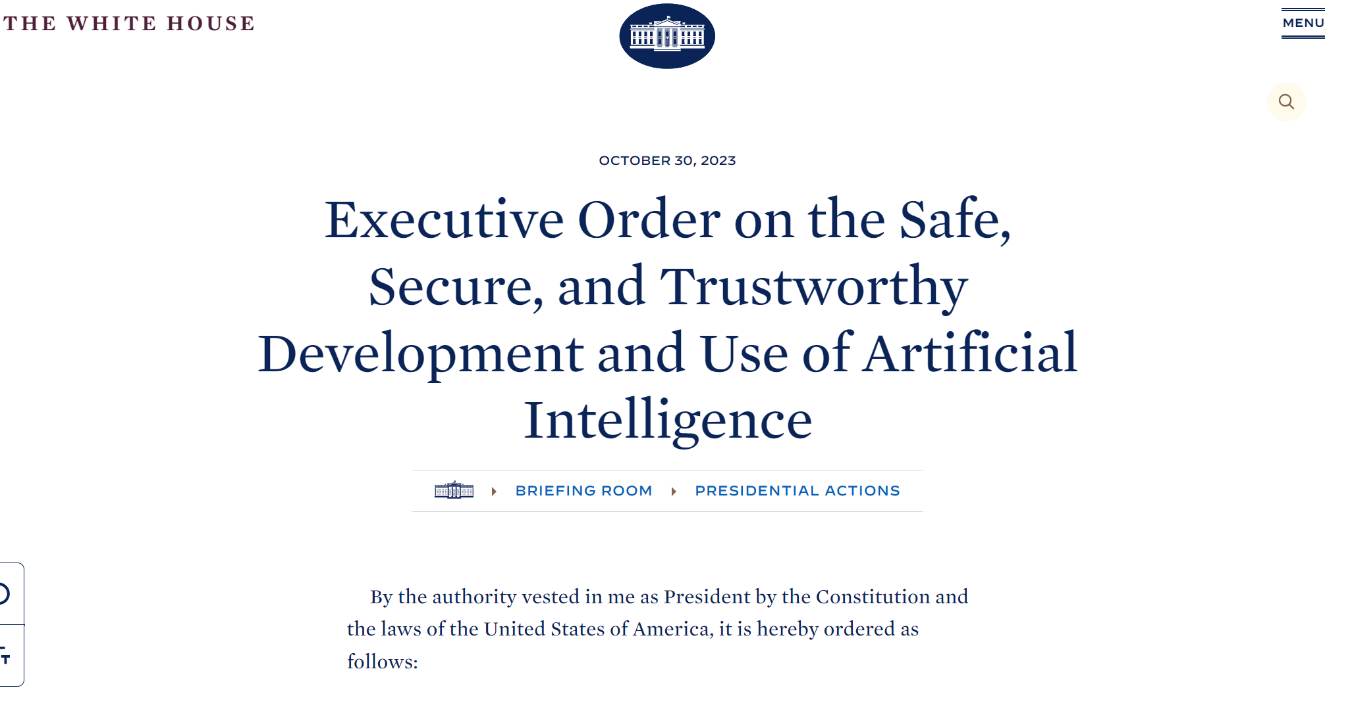
New regulations and requirements to trustworthy AI
Regulations
Requirements
The EU AI Act
Upcoming regulation will set requirements to Trustworthy and Responsible AI
Accuracy
Safety
Robustness Reliability Resilience
Explainability Interpretability Transparency
Bias Fairness
Data quality
Security
Privacy
Notes:
Opportunities , EU
Biden executive order and what to expect
Customers
Challenges, standards
New methods and tools

Slide 9
Key success factors
How tech can provide value
Integrating tech into work processes
Robust operating procedures and policies
Navigating a complex regulatory landscape
Structured change management approach
Comprehensive data management and quality
Assurance requirements for digital assets
Common digital architecture
Notes:
(Use this slide to listen to customers’ experiences on these topics.)
Technology is easy, the people and process bit is hard!
There needs to be a better understanding of how technology will provide value in a specific context
A structured change management approach is required throughout the digitalization process to ensure value is realized
Comprehensive data management and data quality is needed to leverage new technology
Digital assets have different assurance requirements compared to physical assets​
The adoption of common digital architecture is becoming more widespread

Slide 10
Digital Trust by DNV
Digital trust is the confidence users have in the ability of people, technology, data and processes to create a secure and reliable digital world.
Notes:
Digital trust is the confidence users have in the ability of people, technology, data and processes to create a secure and reliable digital world. If you cannot trust your digital asset, you cannot use it in the real world.
DNV seeks to close the trust gap with services and a set of recommended practices for the safe application of industrial AI and other digital solutions so they can get real value from them.

Slide 11
Customer case studies

Slide 12
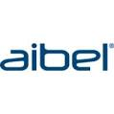
Companies and initiatives we work with
Notes:
Before sharing what we have learned I just want to show which companies and initiatives we have been working with. I am sure that you recognise several of the logos on this slide.

Slide 13
Exploring the potential of digital twins to manage energy transition complexity
Challenge
Digitize gas transmission to:
Today’s gas networks were developed almost exclusively for natural gas
The feasibility of making the transition to H2 using the current infrastructure still needs to be demonstrate
Need to understand the impact of H2 on pipes and assets to ensure safe, efficient and cost effectiveness operation
Company: National Gas
Industry: Gas, H2 transmission
Geography: UK
Web: www.nationalgas.com
Solution
Advisory and assurance on the digital twin solutions developed during the project, using​ Digital Trust recommended practices for assurance.
Impact
Demonstrates that digital twin technology provides a robust, cost-effective solution for managing hydrogen within current gas infrastructure. Greater data visibility allows smart operational, strategic and investment decisions to be made faster
Notes:
Impact
Demonstrates that digital twin technology provides a robust, cost-effective solution for managing hydrogen within current gas infrastructure
Greater data visibility allows smart operational, strategic and investment decisions to be made faster
Supports long-term UK goal of connecting hydrogen production, storage and demand to enable net zero and empower a UK hydrogen economy

Slide 14
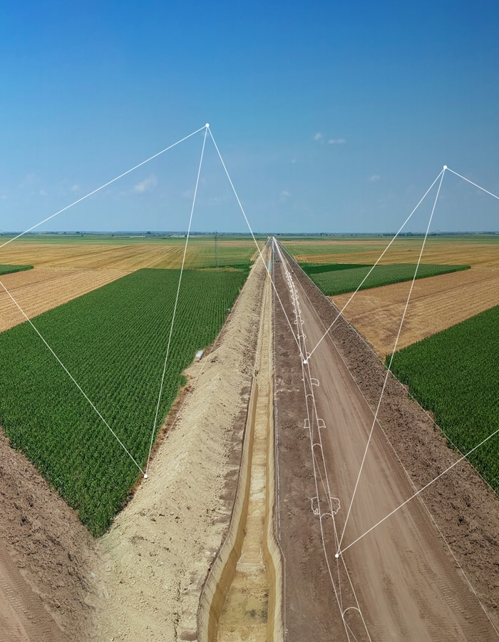
Building trust in AI to enable an intelligent gas grid
Challenge
Digitize gas distribution to:
Reduce Methane Leakage in low-pressure networks.
Enable Pressure-Based Anomaly Detection.
Increase Biomethane Injection into medium-pressure networks.
Company: SGN
Industry: Gas distribution
Geography: UK
Web: www.sgn.co.uk
Solution
Advisory and assurance on the AI/ML solutions developed during the project, using​ Digital Trust recommended practices for assurance of digital twins​, data-driven applications, data quality and industrial AI systems.
Impact
Realising the vision for an “intelligent gas grid” resulting in a more efficient, reliable, and environmentally friendly gas distribution system.
Notes:
Challenge
The project consortia are developing innovative new technology to digitalise the gas distribution networks to:
Reduce methane leakage in low-pressure networks
Enable pressure-based anomaly detection
Increase biomethane injection into medium pressure networks
Solution
DNV are providing digital trust via advisory and assurance services on the AI/ML solutions developed during the project, using​ the following Recommended Practices:
DNV-RP-A204 Qualification and assurance of digital twins​
DNV-RP-0510 Framework for assurance of data-driven applications
DNV-RP-0497 Data quality assessment framework​
DNV-RP-0671 Assurance of Industrial AI Systems (later in the project)

Slide 15
Building trust in digital twin solution VCOG for Visco
Challenge
Improve trustworthiness of the capabilities of the solution
Confidence in product quality and identifying opportunities to improve
Company: Visco
Industry: Digital twin software
Geography: Norway
Web: www.visco.no
Solution
Independent assessment of:
Functionality, performance, and capability
Development, deployment, and maintenance
Technology Readiness Level (TRL)
Impact
Accelerate time to market
Leverage data management expertise for efficient data handling.
Foster Innovation: Ideas to drive future development.

Slide 16
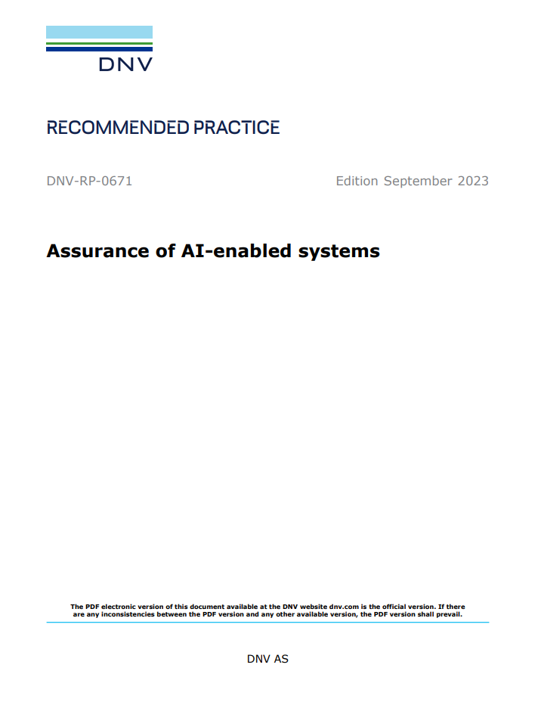
CREATING A SMARTER ENERGY SECTOR WITH TRUSTWORTHY DIGITAL ASSETS
DIGITAL TRUST BY DNV
Design, building and Production/capture
Asset/storage
Calculation/ modelling
Analysis & decision making
Assurance of digital twins
DNV-RP-A204
Data quality management
DNV-RP-0497
Data-driven models and Machine learning
DNV-RP-0510 and DNV-RP-0665
Sensor systems
DNV-RP-0317
Cyber Security
DNV-RP-G108
AI enabled systems
DNV-RP-0671
Asset Information Modelling Framework
DNV-RP-0670
Notes:
In summary, there are significant opportunities for the energy sector to adopt a digital mindset.
Artificial Intelligence and other digital tools can accelerate the energy transition but must gain trust of the sector.
Creating a smarter energy sector relies on digital trust.
AI will add value when there is a business pull rather than a technology push

Slide 17
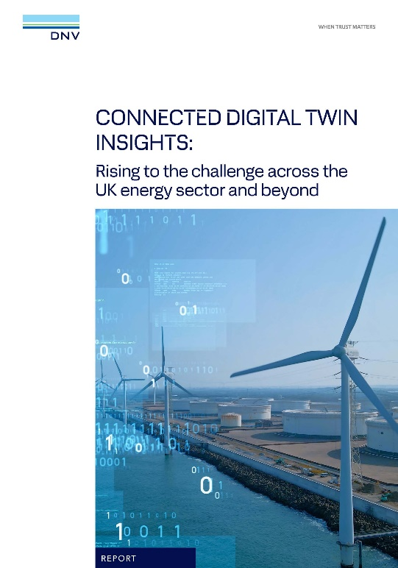
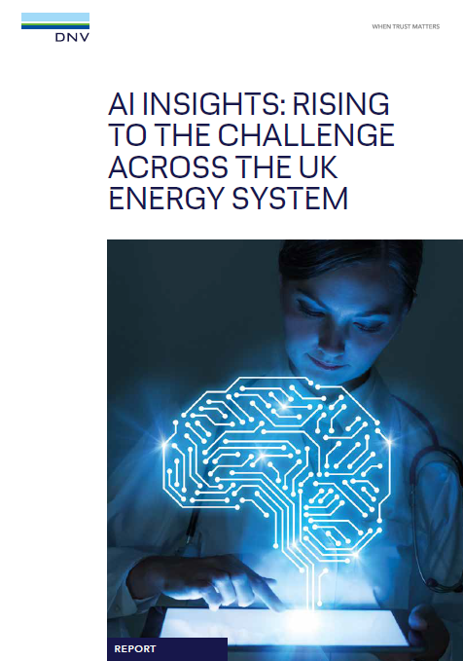
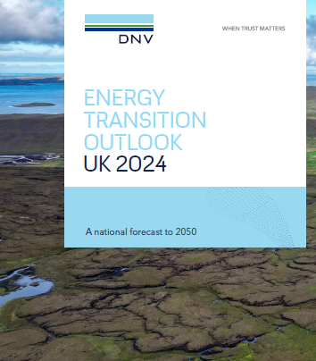
CREATING A SMARTER ENERGY SECTOR WITH TRUSTWORTHY DIGITAL ASSETS
DIGITAL TRUST BY DNV
dnv.com/connected-digital-twins
dnv.com/ai-insights-uk
eto.dnv.com
Notes:
In summary, there are significant opportunities for the energy sector to adopt a digital mindset.
Artificial Intelligence and other digital tools can accelerate the energy transition but must gain trust of the sector.
Creating a smarter energy sector relies on digital trust.
AI will add value when there is a business pull rather than a technology push

Slide 18
Thank you for listening
lars.meloe@dnv.com
graham.faiz@dnv.com

