Slide 1
How the OSDU® Data Platform enables and support Digital Transformation
Einar Landre @ Equinor

Slide 2
Digital Transformation
Chat GPT:
Digital transformation is a strategic imperative for organizations seeking to thrive in the digital age.
It involves more than just adopting new technologies; it requires a fundamental shift in how an organization operates and delivers value.
By embracing digital transformation, organizations can improve efficiency, enhance customer experiences, drive innovation, and maintain a competitive edge in an increasingly digital world.
New ways of working
Difficult and to the point of painful
What has this to do with the OSDU® Data Platform?

Slide 3
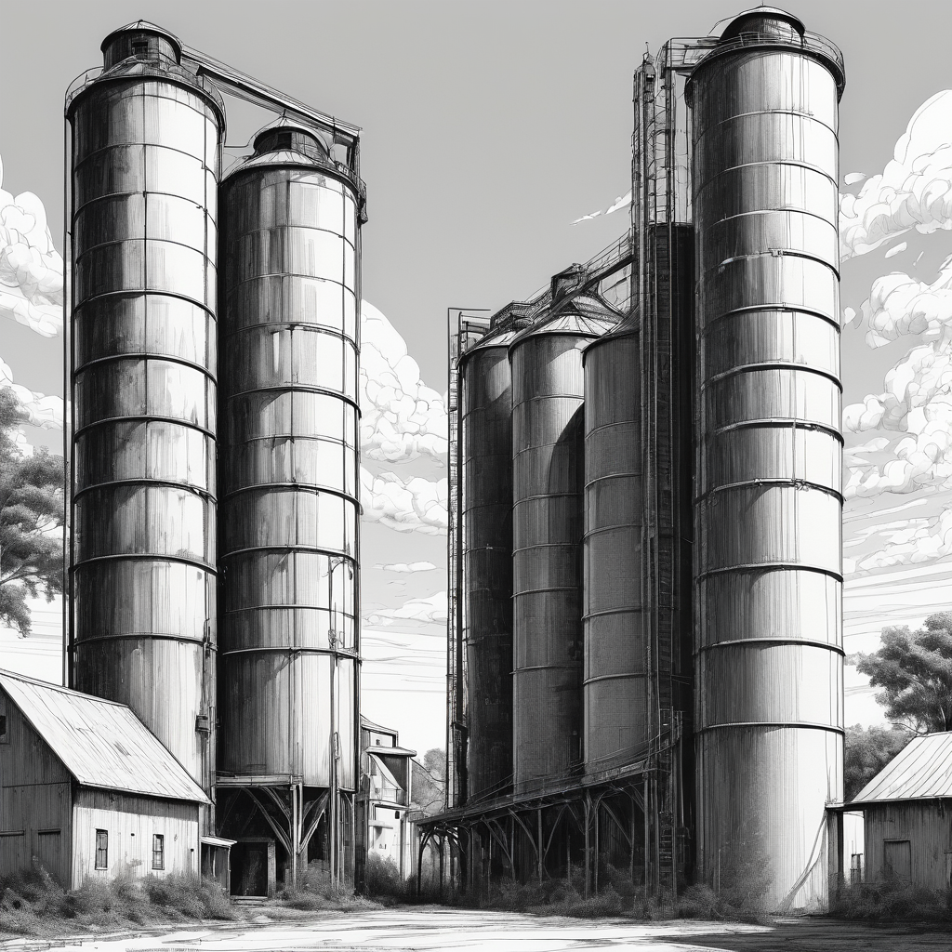
Silos
Silos are useful !!
They contain useful stuff
They separate stuff
They are everywhere
They are efficient
Integrating silos is difficult !!
Connecting mismatching concepts
Interdisciplinary conversations
Medical vs Layman speak
Whisky blending ☺

Slide 4
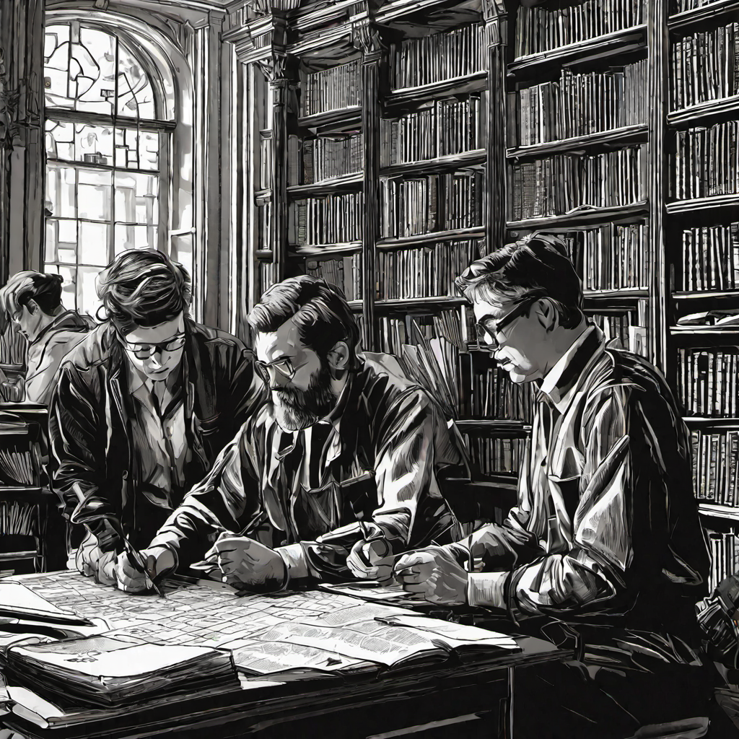
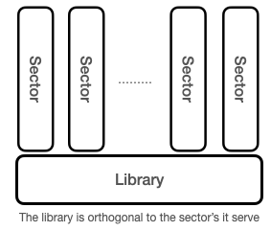
Libraries (of ancient time)
Knowledge factories
Learning and record keeping
Translation, classification and enrichment
Single source of truth

Slide 5
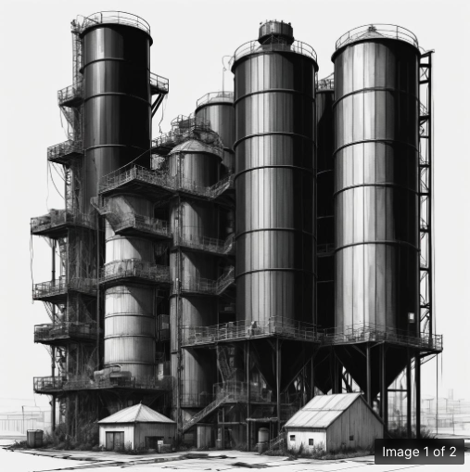
Digital Transformation is enabled by The OSDU® DP
Trustworthy data
Enables new ways of working
Enables digital transformation
Supports the backroom work of data science
Standardized models and terminology
Identification, curation and provenance
Seismic
Earth Modelling
Innovative
New Ways of Working
The OSDU® Data Platform
(Linga franca)

Slide 6
Thank you! Q&A

