Slide 1
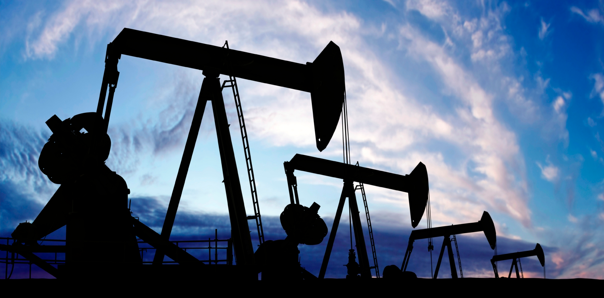
Enhancing oil and gas production with deployable digital process twins
Javier Rodriguez

Slide 2
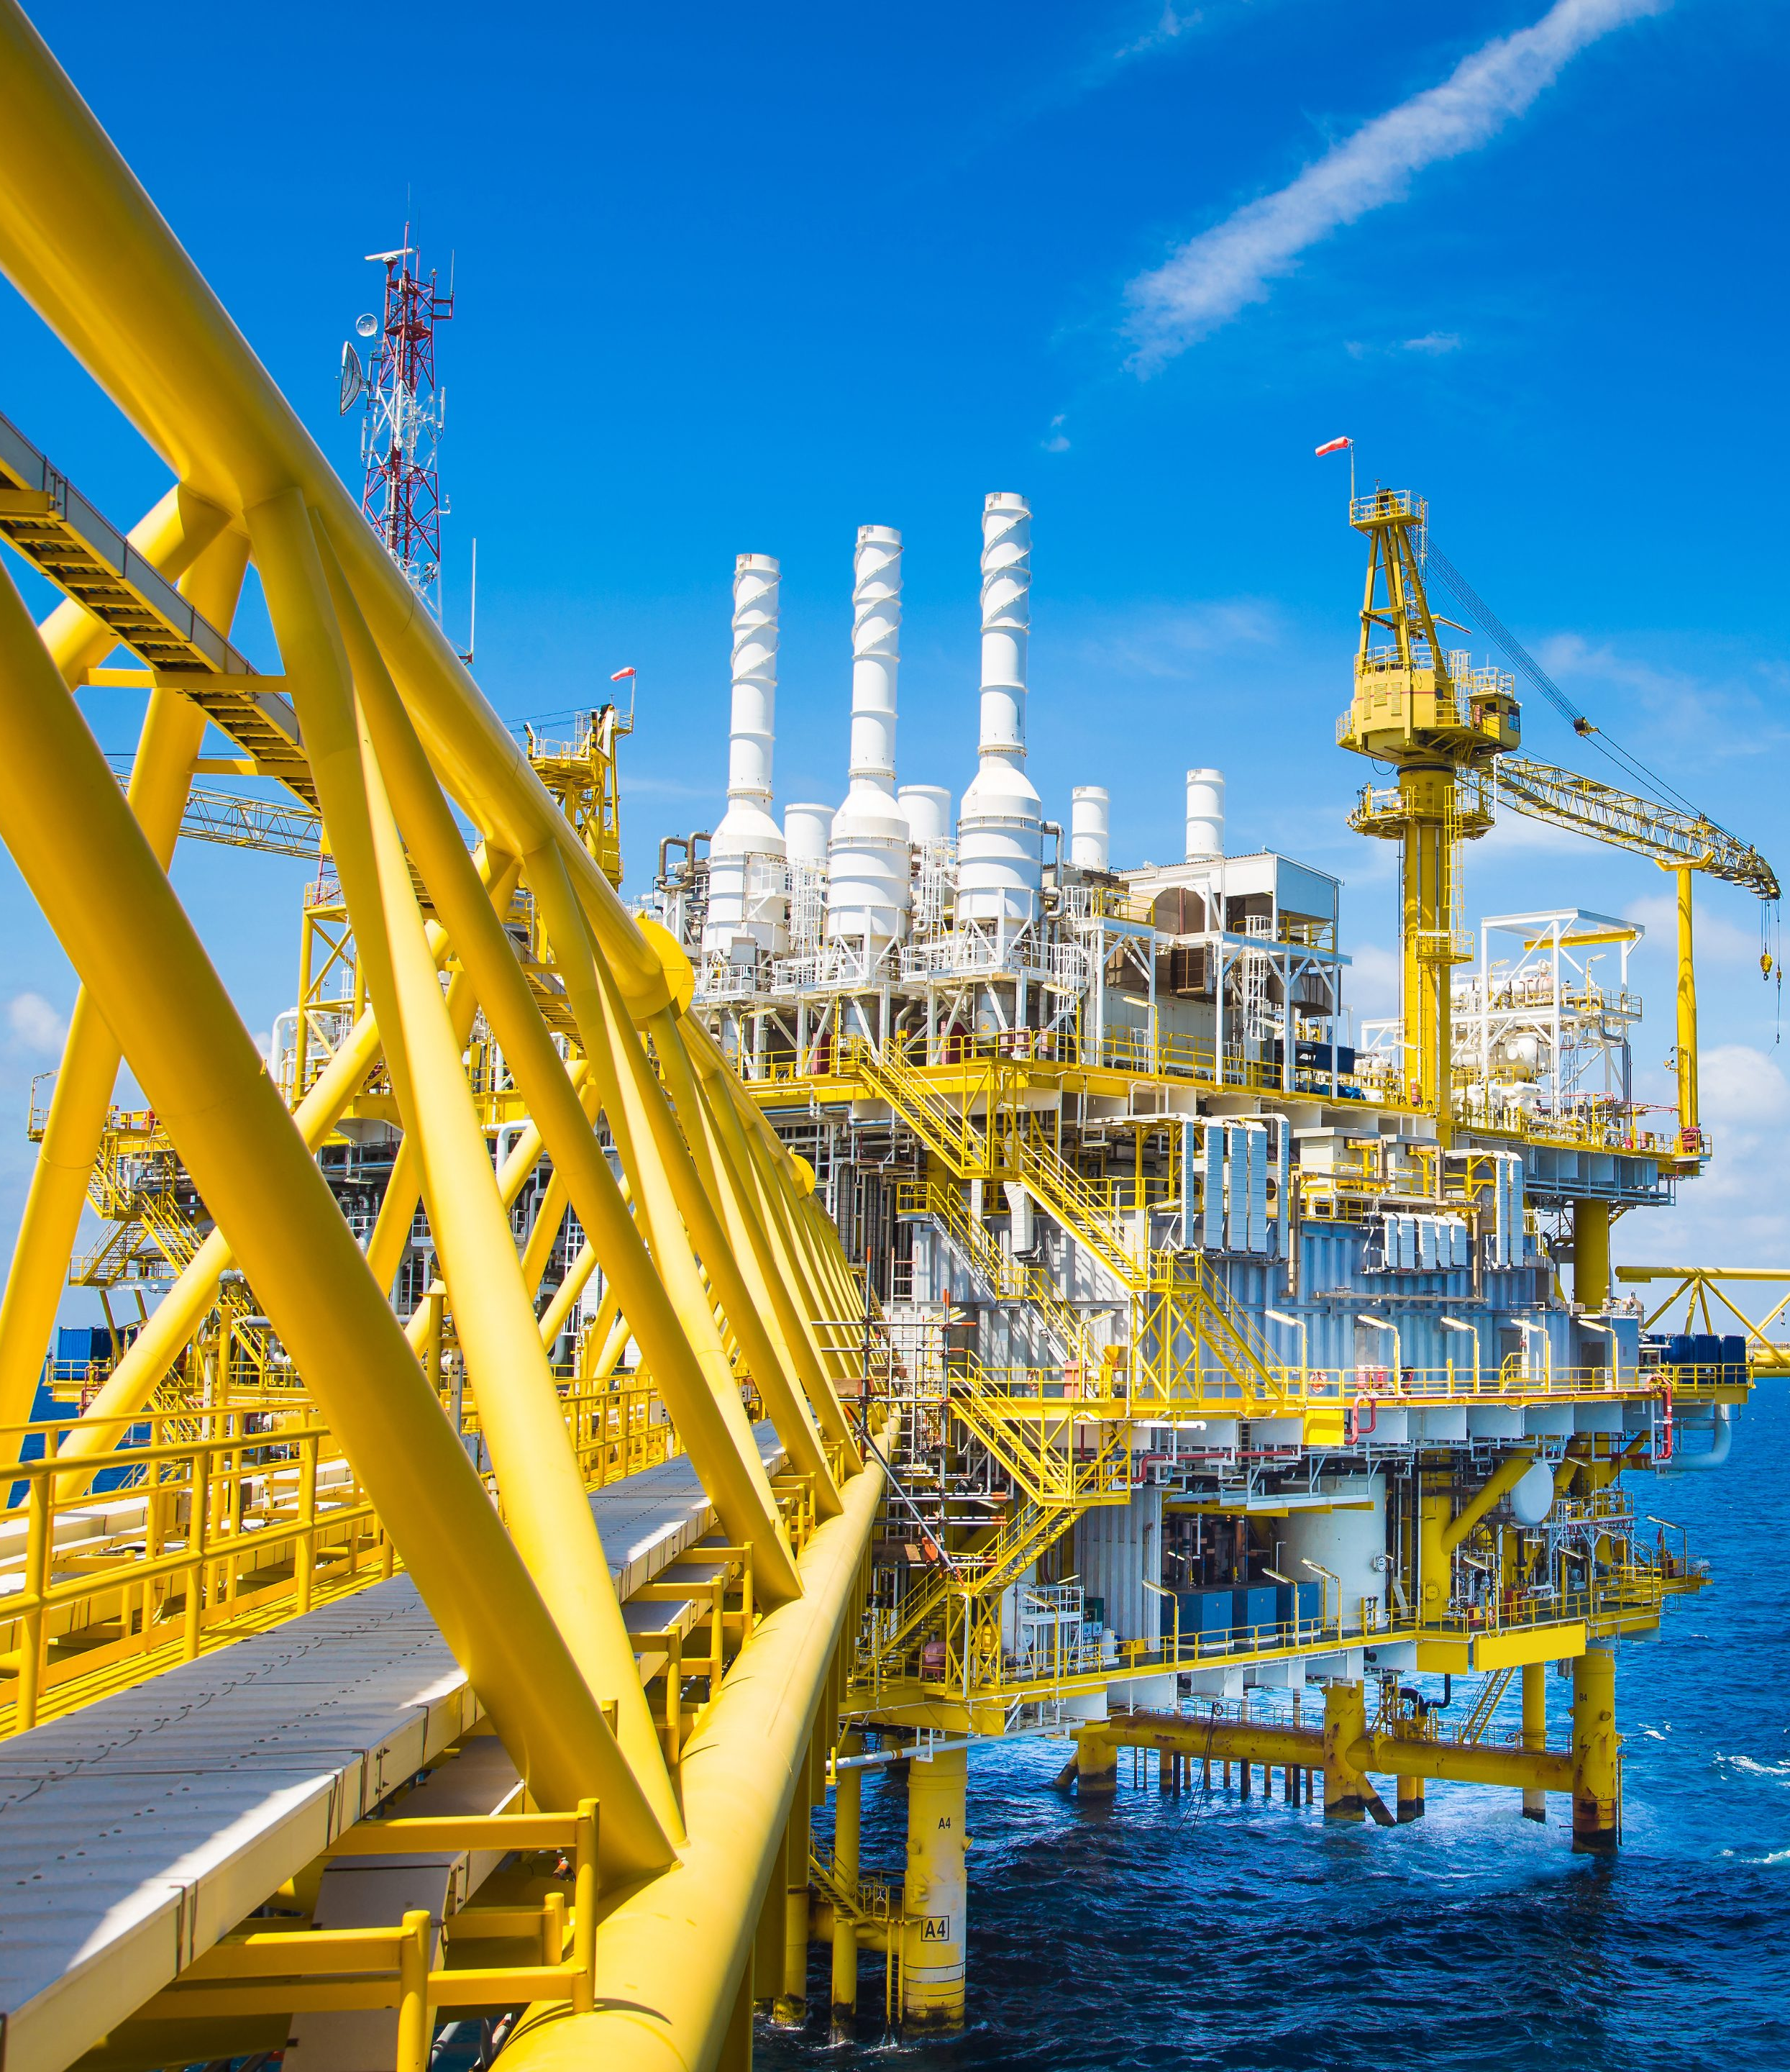
How can operators respond to challenges and stay competitive?
Smart increases in production
Enhance asset productivity while responding to constant process variability and external uncertainties
Drive operational efficiency
Leverage digital technology to keep existing facilities operating efficiently and reduce cost of production without new CAPEX investment
Minimise carbon footprint
A broader transition to net zero is motivating ambitious reductions in energy use and CO₂ emissions in all operating assets

Slide 3
Oil and gas production today
Profit loss due to untapped productivity
Why?
Opportunities to improve performance are often not realised due to huge operational complexity

Slide 4
Oil and gas production today
100s of operational decisions
Wells: Availability, choke, gas lift
Gathering network: Routing combinations, manifolds, risers
Facilities: Separator pressure, rotating equipment, etc.
100s of operational constraints
Wells: Drawdown, lift, backpressure, fluid velocities, etc.
Gathering network: Erosional and corrosional velocities, pressures
Facilities: Equipment capacities, export pressures, product specs
Variability and fluctuation
Process variability will change the optimal point frequently
External uncertainties may impact operations at short notice
A constant need to re-optimise

Slide 5
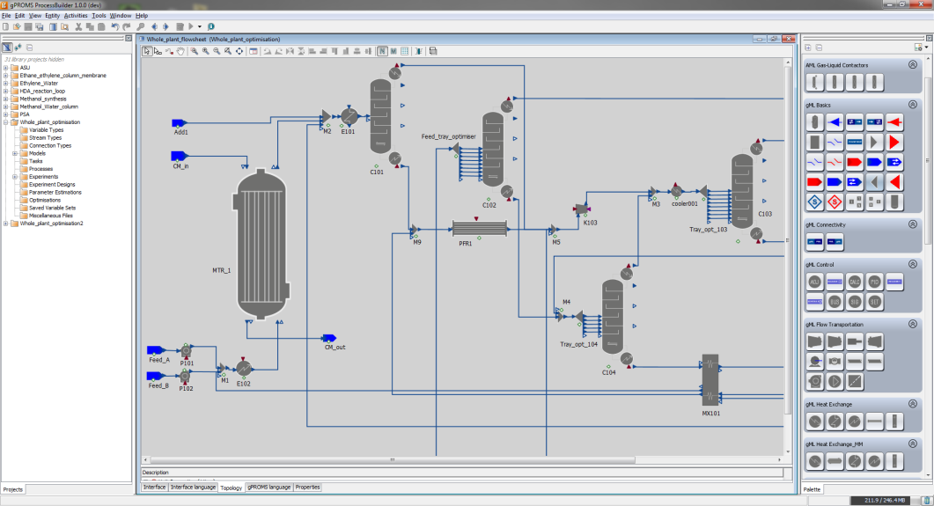
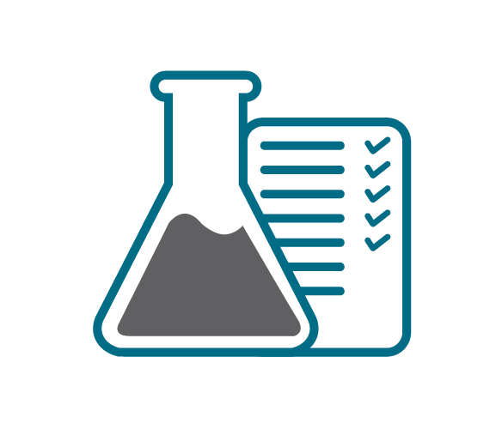
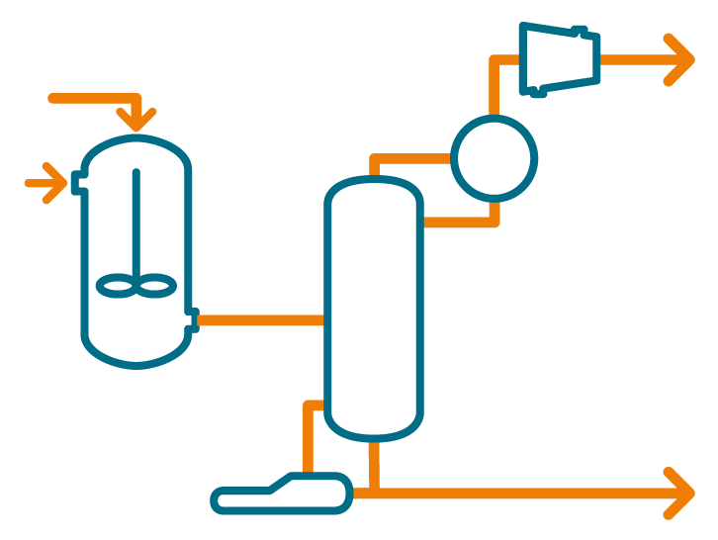
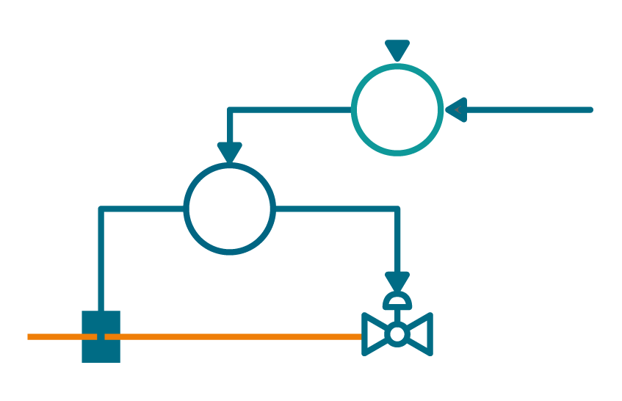
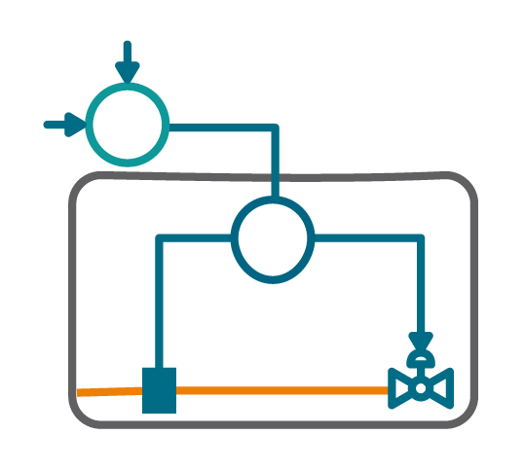
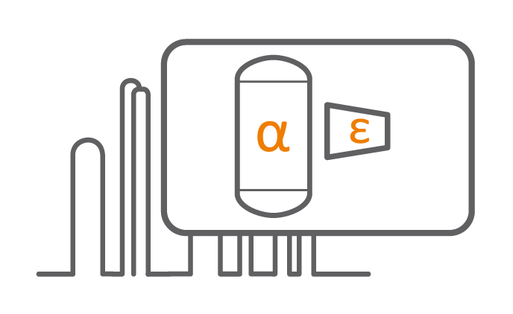
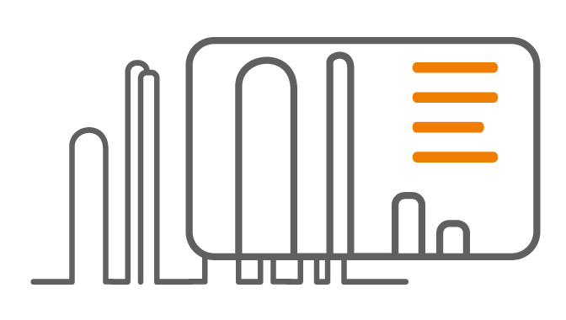
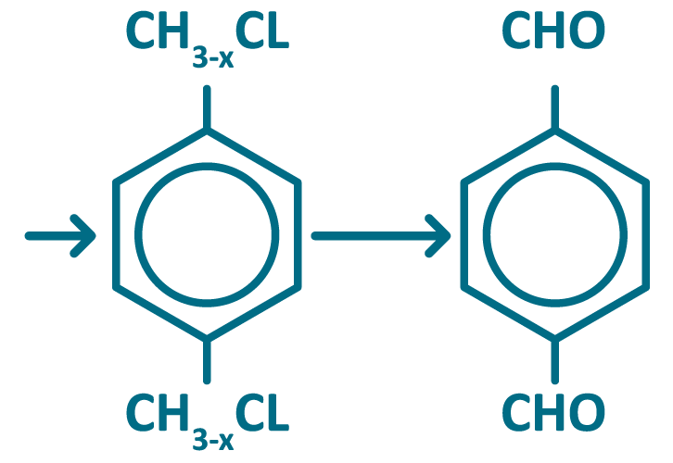
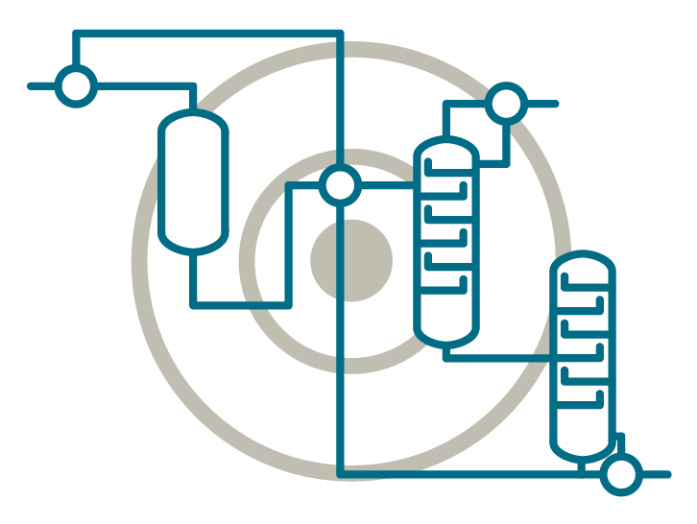
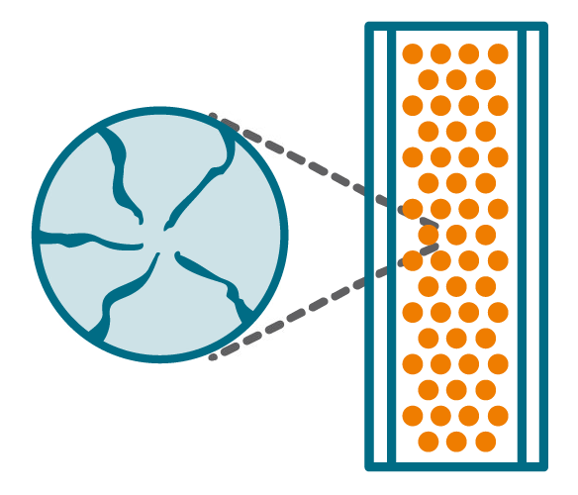
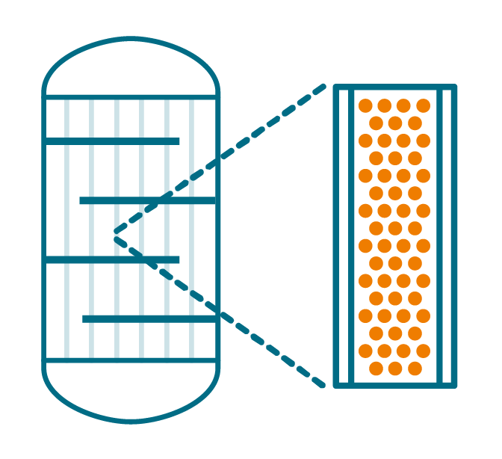
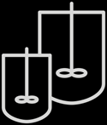
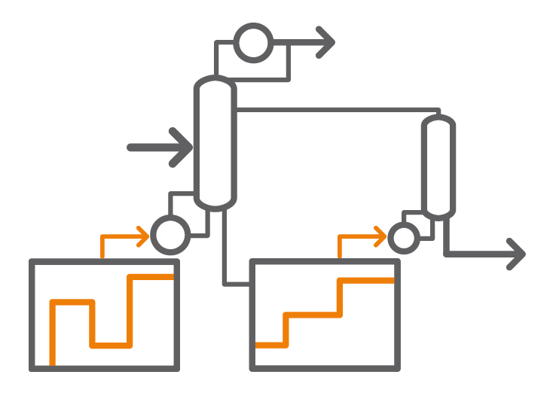
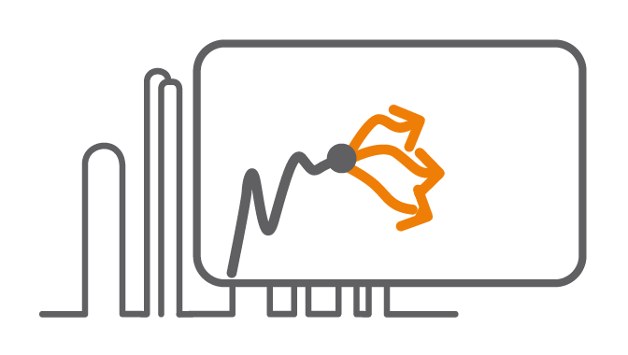
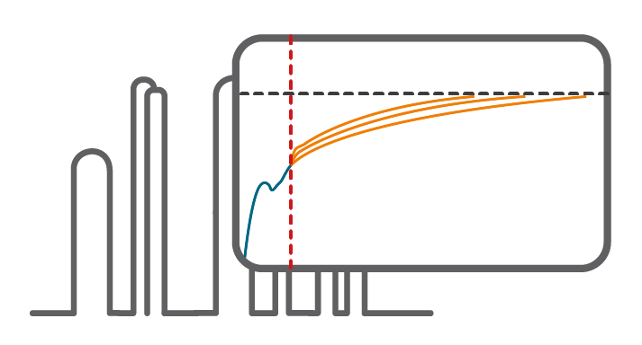
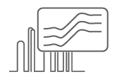
Siemens Process Digital Twin
Value across the entire asset lifecycle
Single, evolving, physics-based model, embodying deep process knowledge, built in a unified platform
DIGITAL R&D & DESIGN
Accelerate development, optimize design, manage risk
DIGITAL OPERATIONS
Monitor, soft-sense, optimize real-time operation
[with Siemens SIMIT]
Data analysis, experiment design
Front-end engineering design (FEED)
Control design & verification
Process monitoring
Soft-sensing
Real-time optimisation
Conceptual process design
Virtual commissioning
Process optimisation
Understanding microscale phenomena
Detailed equipment design
Scale-up & Tech transfer
Run length prediction
Operations decision support
Operating policy
Operator training
Model-predictive Control
R & D
E N G I N E E R I N G D E S I G N
O P E R A T I O N S

Slide 6
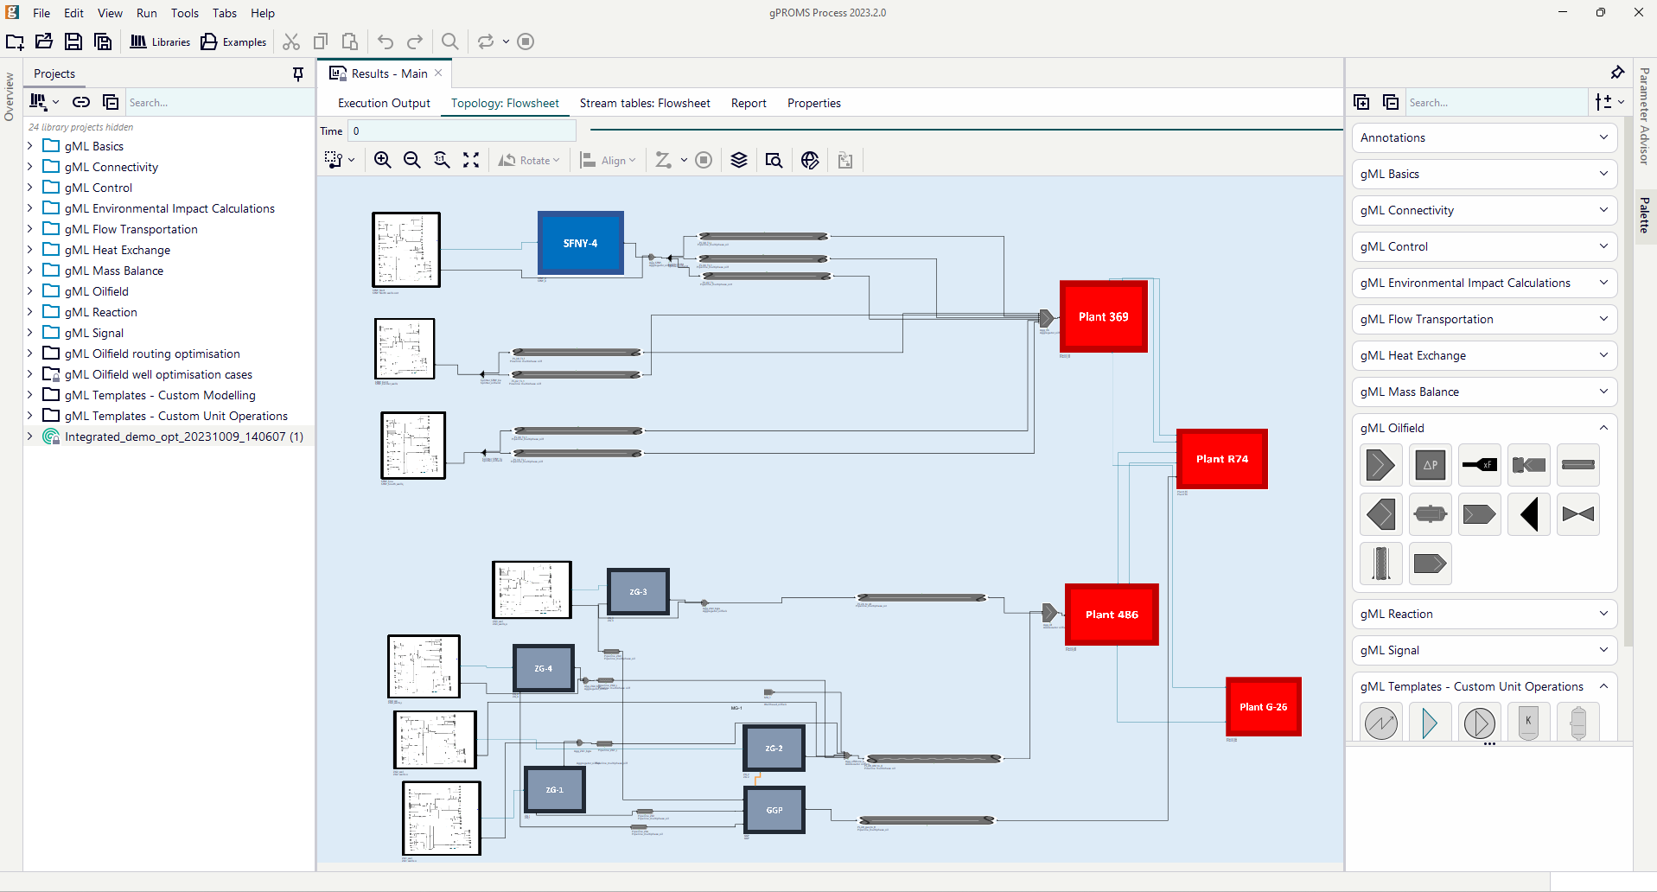
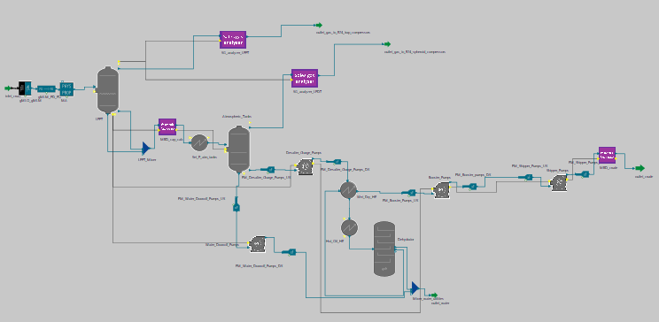
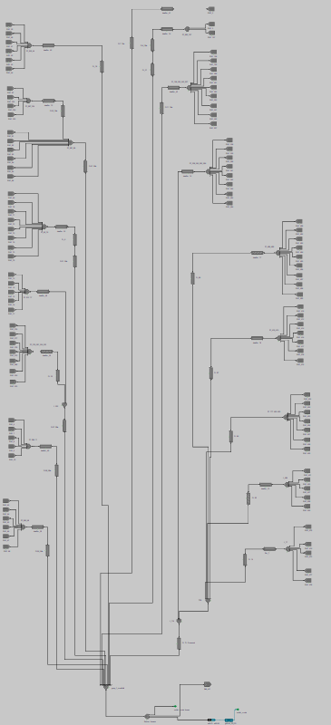
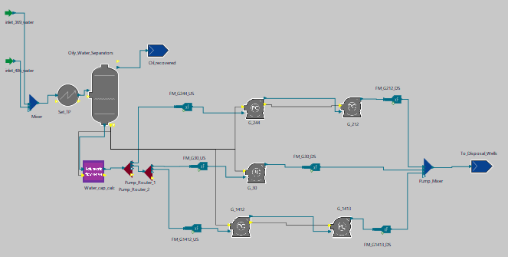
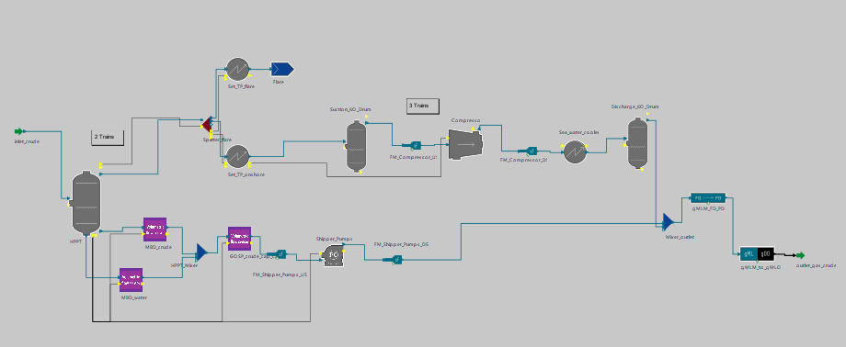
Siemens Process Digital Twin What is currently possible for O&G assets? Large-scale example
Offshore
Onshore
Onshore gas oil separation plant
Wells & gathering network
Onshore gas compression plant
Offshore gas oil separation plant

Slide 7
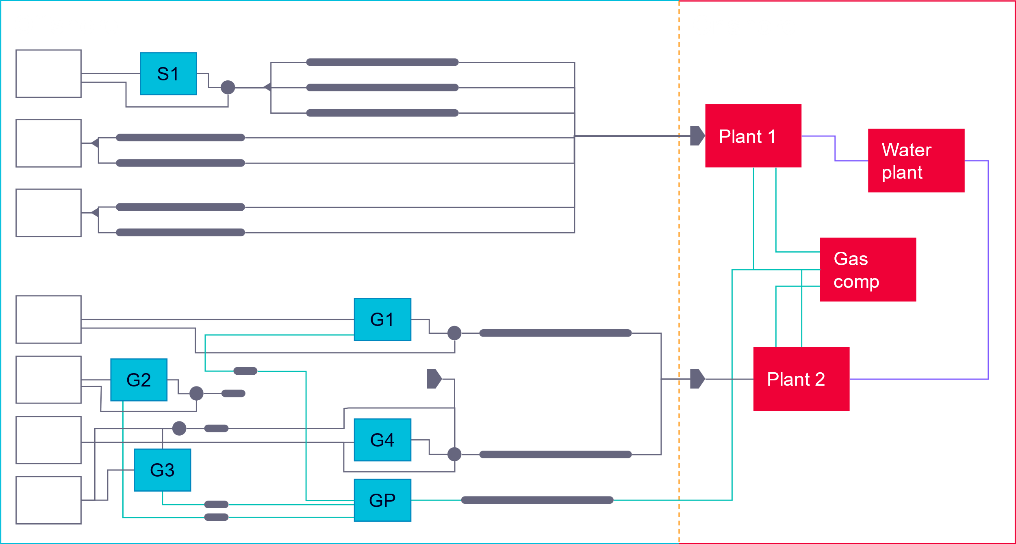
Siemens Process Digital Twin What is currently possible for O&G assets? Large-scale example
gPROMS Process end-to-end model
1. Wells
Nodal analysis
Fluid definition
Min FBHP, erosional velocity constraints
2. Gathering network
Topography
Multiphase pressure drop correlation
Heat transfer
Erosional and custom constraints
Routing
3. Offshore and onshore facilities
Separators, rotating equipment
Columns (surrogates for very complex equipment)

Slide 8
Siemens Process Digital Twin What is currently possible for O&G assets? Large-scale example
How to best operate the asset
Optimisation problem formulation
Optimisation objective
Maximise production
Maximise profit
Minimise costs
Maximise profit for specific shareholder
…
Optimisation decisions
Well head/riser choke differential pressure
Gas lift injection at wells/risers, ESP performance
Separator operating conditions
Wells on or off
Routing: Wells to risers; risers to separators
gPROMS optimisation solver: MINLPOA
Proprietary “next-generation” Outer Approximation algorithm
Incorporates lessons from extensive testing in production optimisation and other process engineering applications
Automatic identification & specialised handling of some constraint classes
New NLPMSO solver for globalized solution of continuous sub-problems (NLPs) to handle non-convexities
… Tightly integrated with MILP master problem
Distributed computation (next gPROMS version)
Execution on multicore machines & compute clusters/cloud
Optimisation constraints
Equipment processing capacities
Velocity limits in pipes to avoid erosion
Gas lift availability
Maximum number of changes in discrete settings from current Routing logic

Slide 9
Siemens Process Digital Twin What is currently possible for O&G assets? Large-scale example
~400k equations
~700 offshore wells integrated with onshore facilities
~1,100 decision variables (620 discrete)
~2,000 constraints
Optimal solution obtained in ~20’

Slide 10
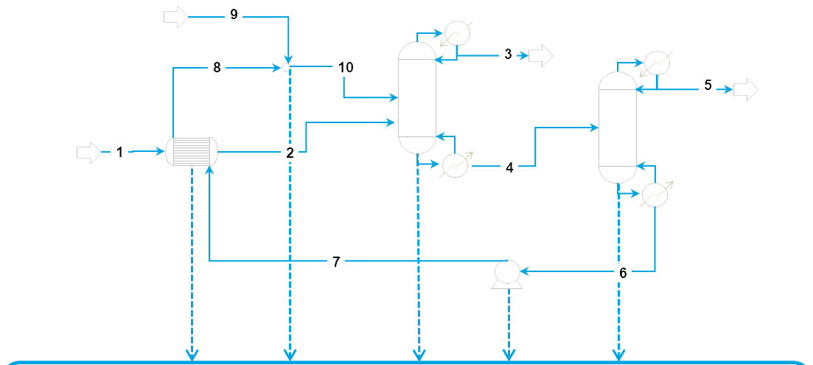
Why is this possible?
The Sequential Modular (SM) approach
Advantages
Easy to use; quick for simple calculations
Failure is rare; clear diagnostics issued
Disadvantages
“Downstream” specifications
Recycles slow to converge; multiple recycles difficult
Adding new custom models – need to code solution method
Poor optimization capability
Many other limitations
The Equation Oriented (EO) approach
Advantages
Can specify any variable subject to degrees of freedom – “downstream” specifications easy
Fast, robust convergence of pressure-driven flowsheets
Powerful custom modelling – easy to include user IP (new models, constraints, correlations)
Very powerful optimization
f(x) = 0
One large set of equations (10³-10⁶ variables)
Solved simultaneously
[Traditional] Disadvantages
May fail to find an initial solution easily
Often difficult to find reason for failure
Deployed Process Digital Twins for operations
Notes:
is deployed solutions for operations

Slide 11
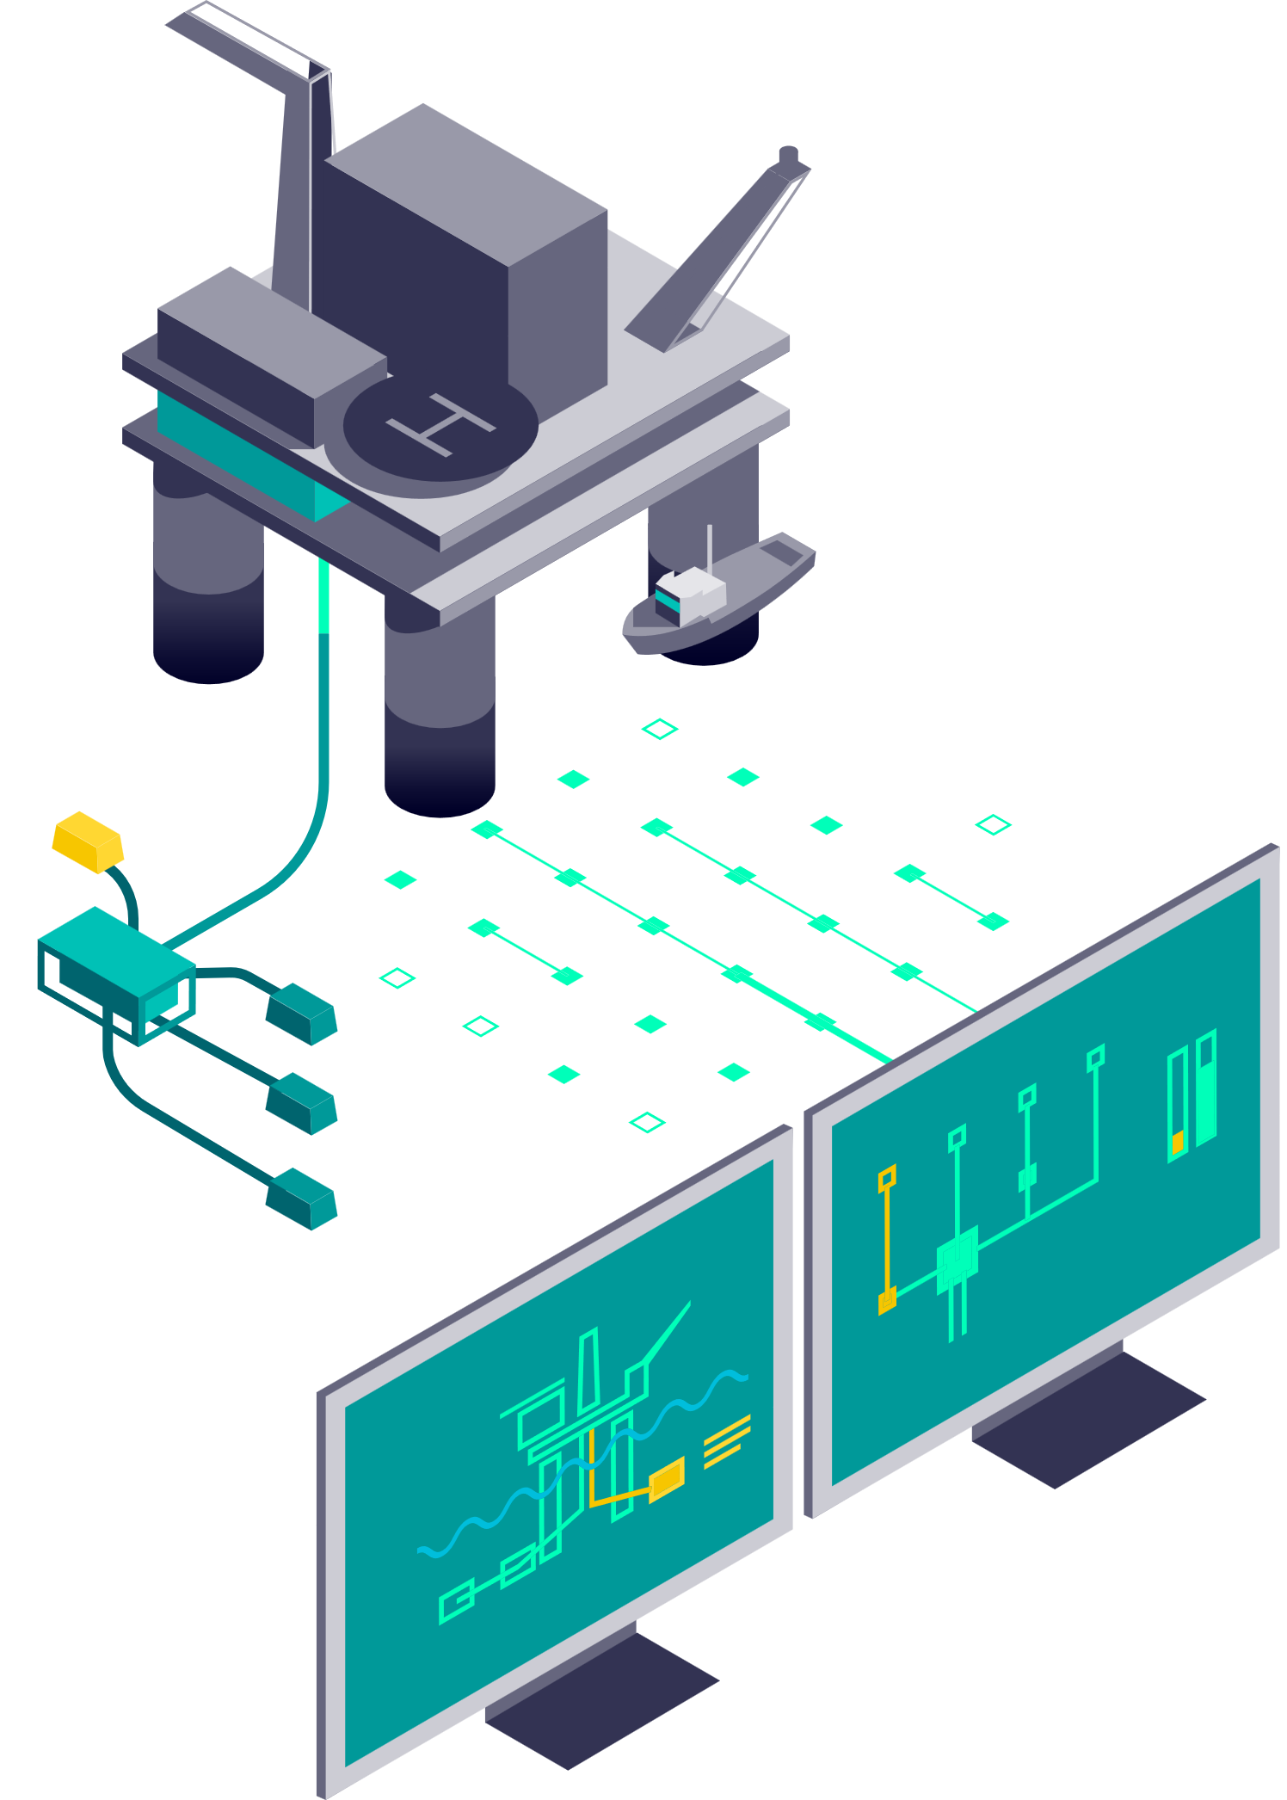
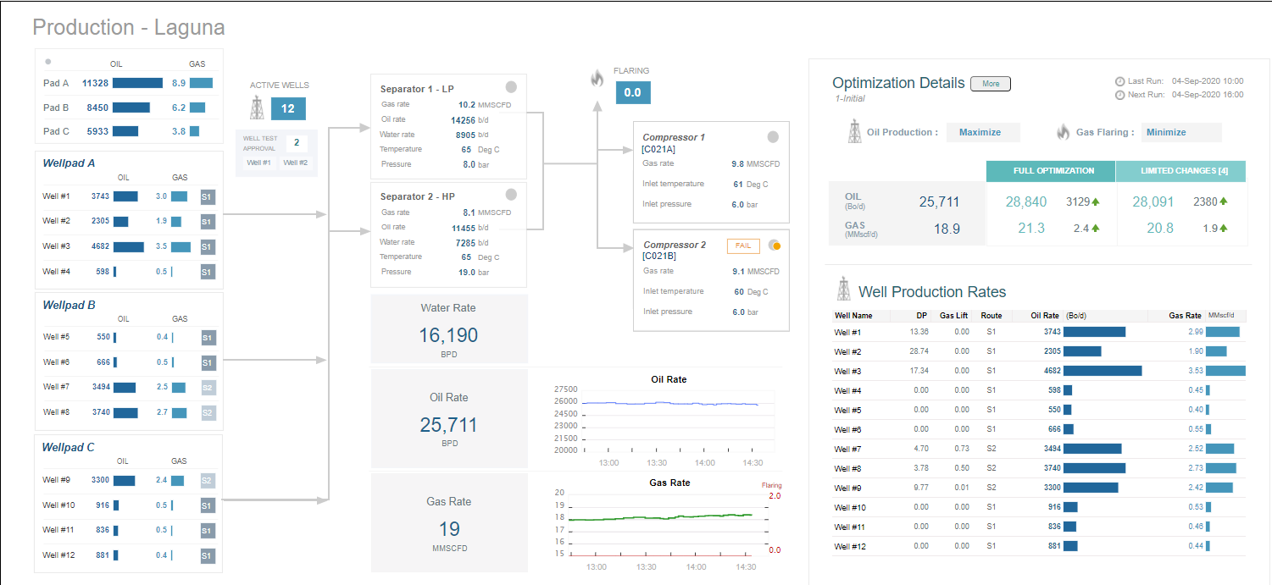
Deployed Digital Twins
Real-Time Optimisation (RTO) solution that is deployed in the control room and meets the operator needs.
Real-Time Optimisation
True integrated asset modelling
Bespoke for each asset
Scenario analysis, field planning
Soft-sensing

Slide 12
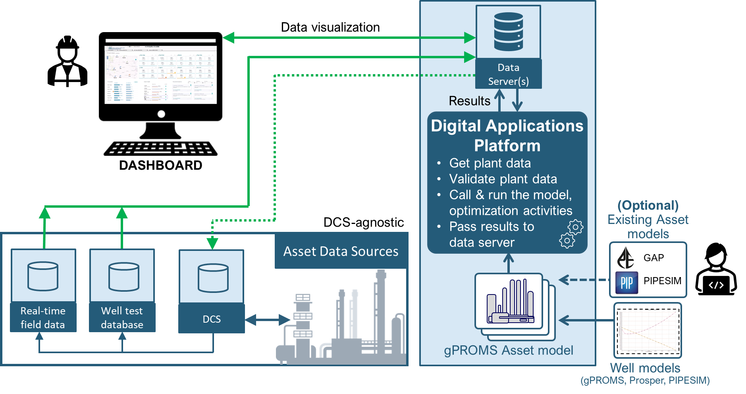
Deployed Digital Twin The Siemens Oilfield Optimiser is deployed in the control room as an online digital solution
Real time optimisation via SIEMENS Oilfield Optimiser
Real-time information
Utilise field data to update the model in real time, enabling accurate optimisation of the true asset condition
Solution Architecture
Accessibility and usability
Deployed solutions require minimal user training to use effectively
Dashboard-based tools provide easy access to information for all stakeholders
Deliver impact efficiently
Utilise results from Day 1
Complement the existing portfolio of modelling tools
Typical ROI of <6 months*
*Depends on asset characteristics

Slide 13
Deployed Process Digital Twin technology in O&G applications
Empowers operators with robust, accurate, and implementable solutions
End-to-end
models
Predictive
models
Optimisation flexibility
Best-in-class speed
Incorporate all asset components in a single modelling environment
Wells, Routing, GOSP, Compression
Apply equation-oriented modelling to the entire asset simultaneously
Remove the unreliability of multi-model analysis
Avoids information silos
Physics-based models capture actual field operation predictively
Exhaustive provision of model variables to reflect true operator decision-making
Full control over model configuration; no black-boxes
Reflect field behaviour at all times
In-built mixed-integer optimizer handles discrete and continuous decisions
Limit the number of changes allowed to ensure solutions are feasible to implement
Optimisation problem (objective, controls & constraints) is fully customizable
Optimal solutions that can be delivered to operators & match their priorities
Equation-based models and solvers are highly-efficient
Generate results in minutes instead of hours or days
Enables an unparalleled frequency of optimisation, which operators can use to reflect field variability and investigate what-if scenarios
Be ahead of the curve during operation

Slide 14
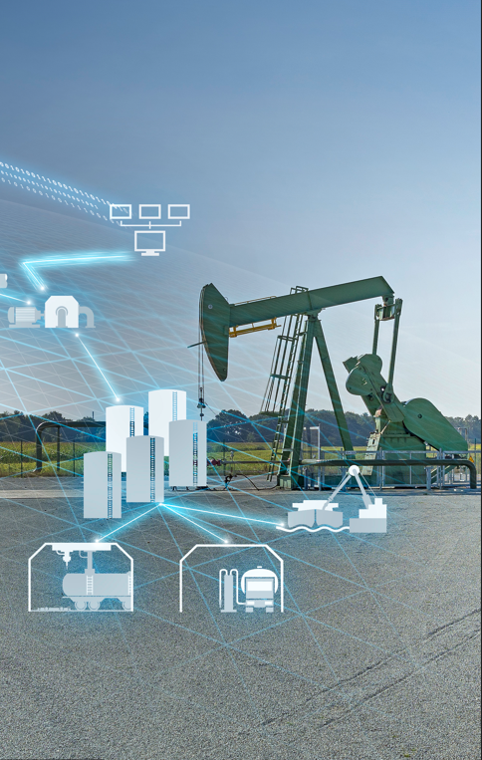
Customer use cases Optimisation of unconventional oil field in North America
Siemens Energy/Major Oil Operator in North America
​Customer challenge
Existing models did not capture field behavior
Gas lift is purchased; optimising use is therefore critical
Solution: Field Optimisation model embedded in partnership with Siemens Energy
Data acquisition & validation system
Automatic well model generation from field data
Automatic daily optimisation
Dashboard for
optimal set points display
input for what-if scenario configuration
Benefits
13% increase in condensate production
~50% reduction in gas lift gas (~$3.9 M saving per year)
Always up-to-date model available for field re-optimisation when field issues occur
Improved understanding of the impact of planned changes
4 M$/yr savings per year
~$3.9M/yr additional savings

Slide 15
Customer Use cases Offshore & onshore GOSP network planning optimisation
Middle-East national oil company
​Customer challenge
Large-scale complex production and separation network
Many trade-offs and operating limits
Primary goal: Minimise power consumption (ESPs and plant rotating equipment) for a specified production target
Solution: Web-based planning optimisation
Offline solution with customised dashboards
Data entry and results visualisation
On-demand optimisation capability
Benefits
Up to 51% reduction in power consumption
Single solution encompassing production and processing facilities facilitates internal collaboration by eliminating silos
Always up-to-date model available for on-demand optimisation
Up to -51%
Power consumption
The Aramco Journal of Technology Fall 2020: “A rigorous mixed integer nonlinear programming model to optimize the operation of an integrated gas-oil separation network ”

Slide 16
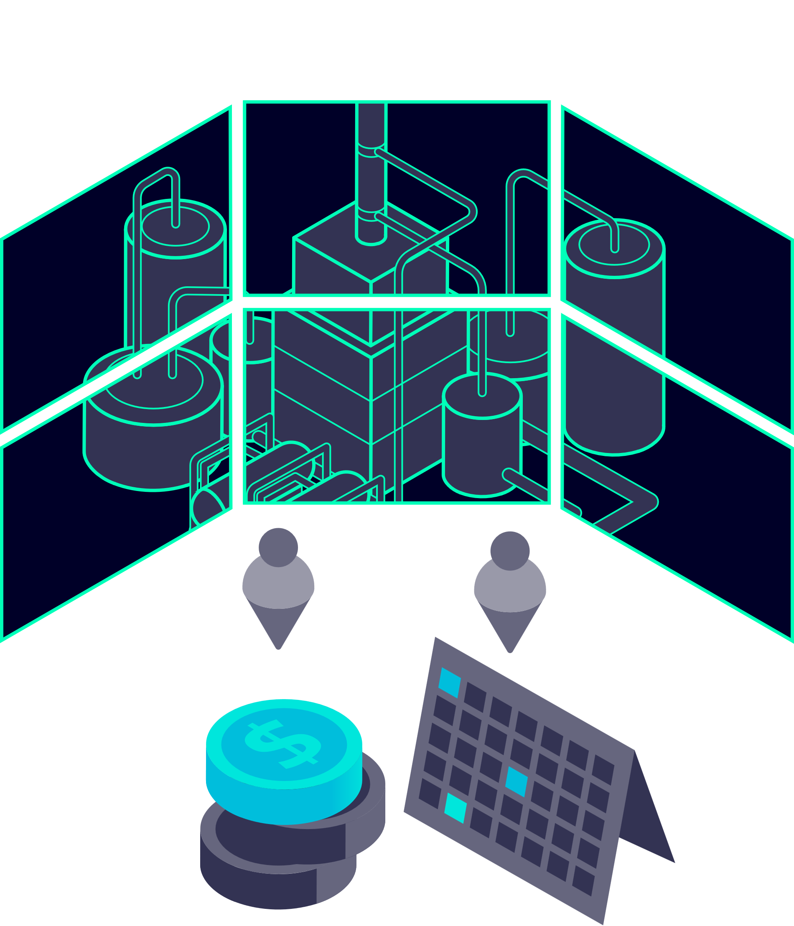
Deployed Process Digital Twins Benefits
Real-Time Optimisation (RTO) of assets can push the process operating envelope to:
With a solution deployed and running in real-time, these results can be achieved with:
Maximise production of oil and gas
Reduce energy consumption and carbon emissions
1-5% increase
10-20% savings
Reduce flaring with no loss of production
Reduce artificial lift requirements
Up to 80% reduction
Up to 50% lower
NO ADDITIONAL CAPEX OR ASSET UPGRADES
A CONTROL ROOM ADVISOR THAT CAN OPTIMISE RAPIDLY

